Slide 1
Undersmoothed HAL-based plugin estimator for direct/indirect effects
Develop and test undersmoothed HAL-based plugin estimator for direct/indirect effects, or other more complex parameters.
Seraphina

Slide 2
Undersmoothing
Getting the initial lambda
from a HAL fit with smoothness_orders = 0
Getting the undersmoothed lambda:
Generate a panel of lambdas
initial lambda * seq(from=0, to=-3, length=20)
Pick the first lambda that satisfies the criteria:
Max score <= 1/(sqrt(n) * log(n))
Where max score = max(|E[(Y – Y_hat)(H/sigma_n)]|)

Slide 3
Controlled direct effects
Data structure:
W: baseline, continuous
A: treatment dosage, continuous, bounded
Z: intermediate curve, binary
Y: outcome, binary
Causal target parameter:
Dose response curve, over grid of a

Slide 4
Controlled direct effects - simulations
Generate data with given sample size n with the given DGD
Fitting the Y ~ X directly with undersmoothed HAL using the sample once
max_degree = 3
smoothness_orders = 1
base_num_knots_0 = 20
base_num_knots_1 = 20
Estimating the targeted parameter by calculating the simple substitution estimator
Predicting given a and z
using the fitted undersmoothed HAL for all combinations of a and z

Slide 6
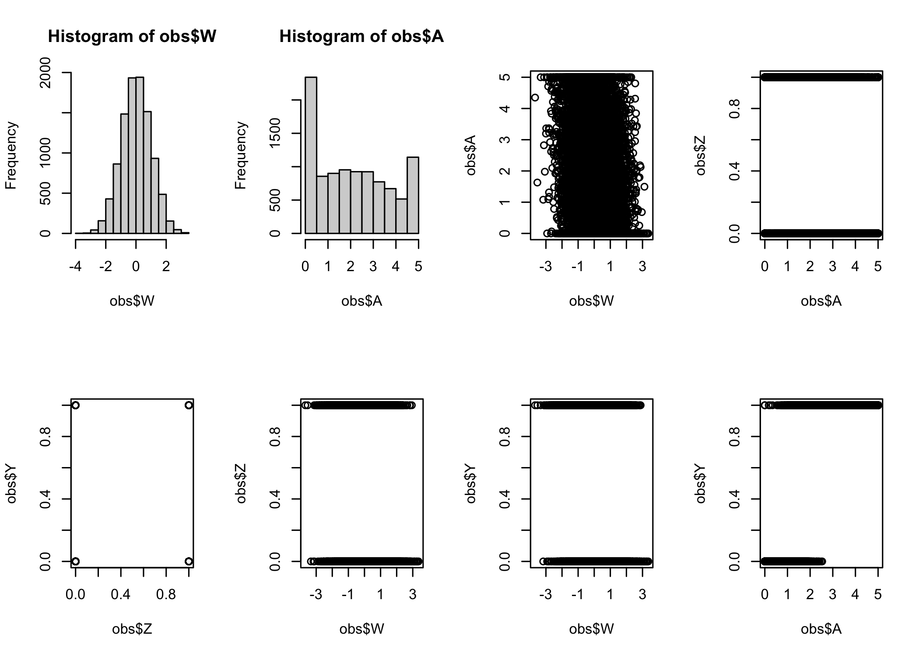
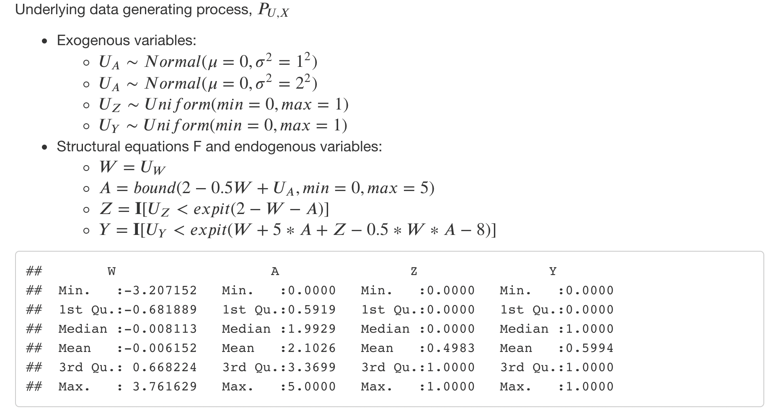
Simulation #1

Slide 7
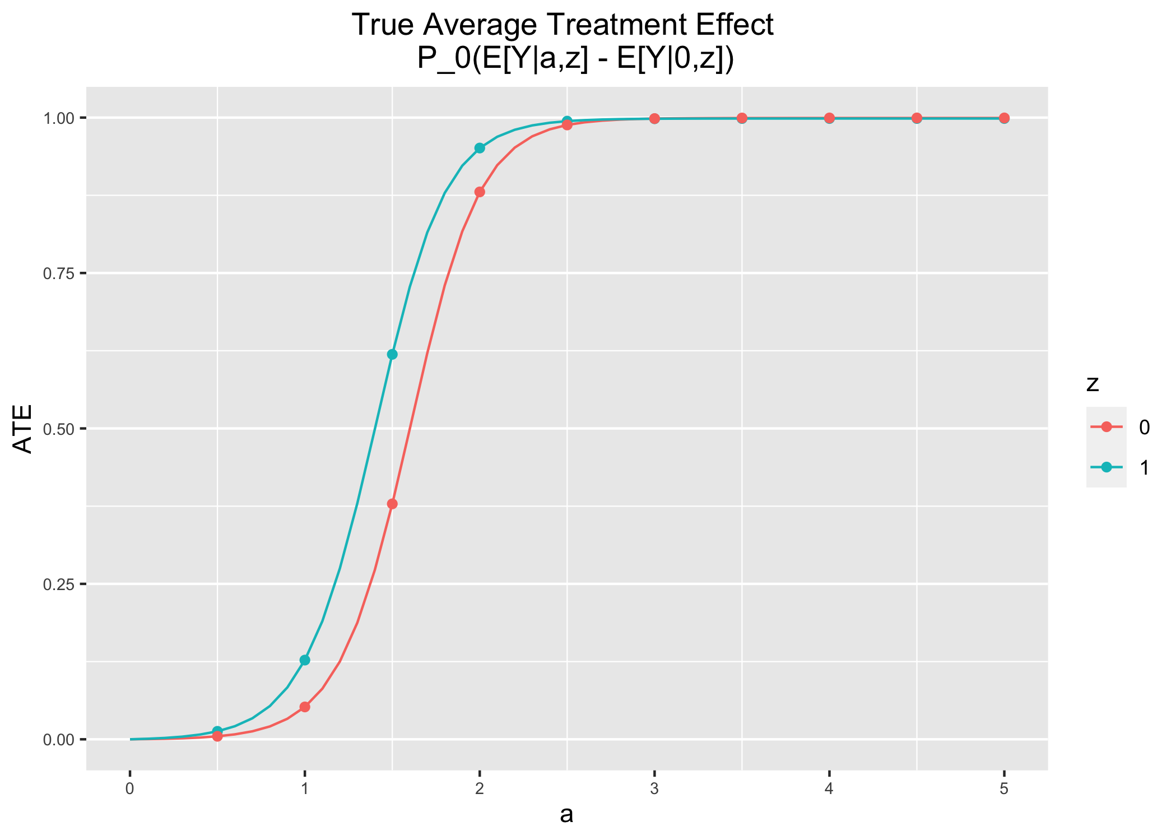
Simulation #1

Slide 8
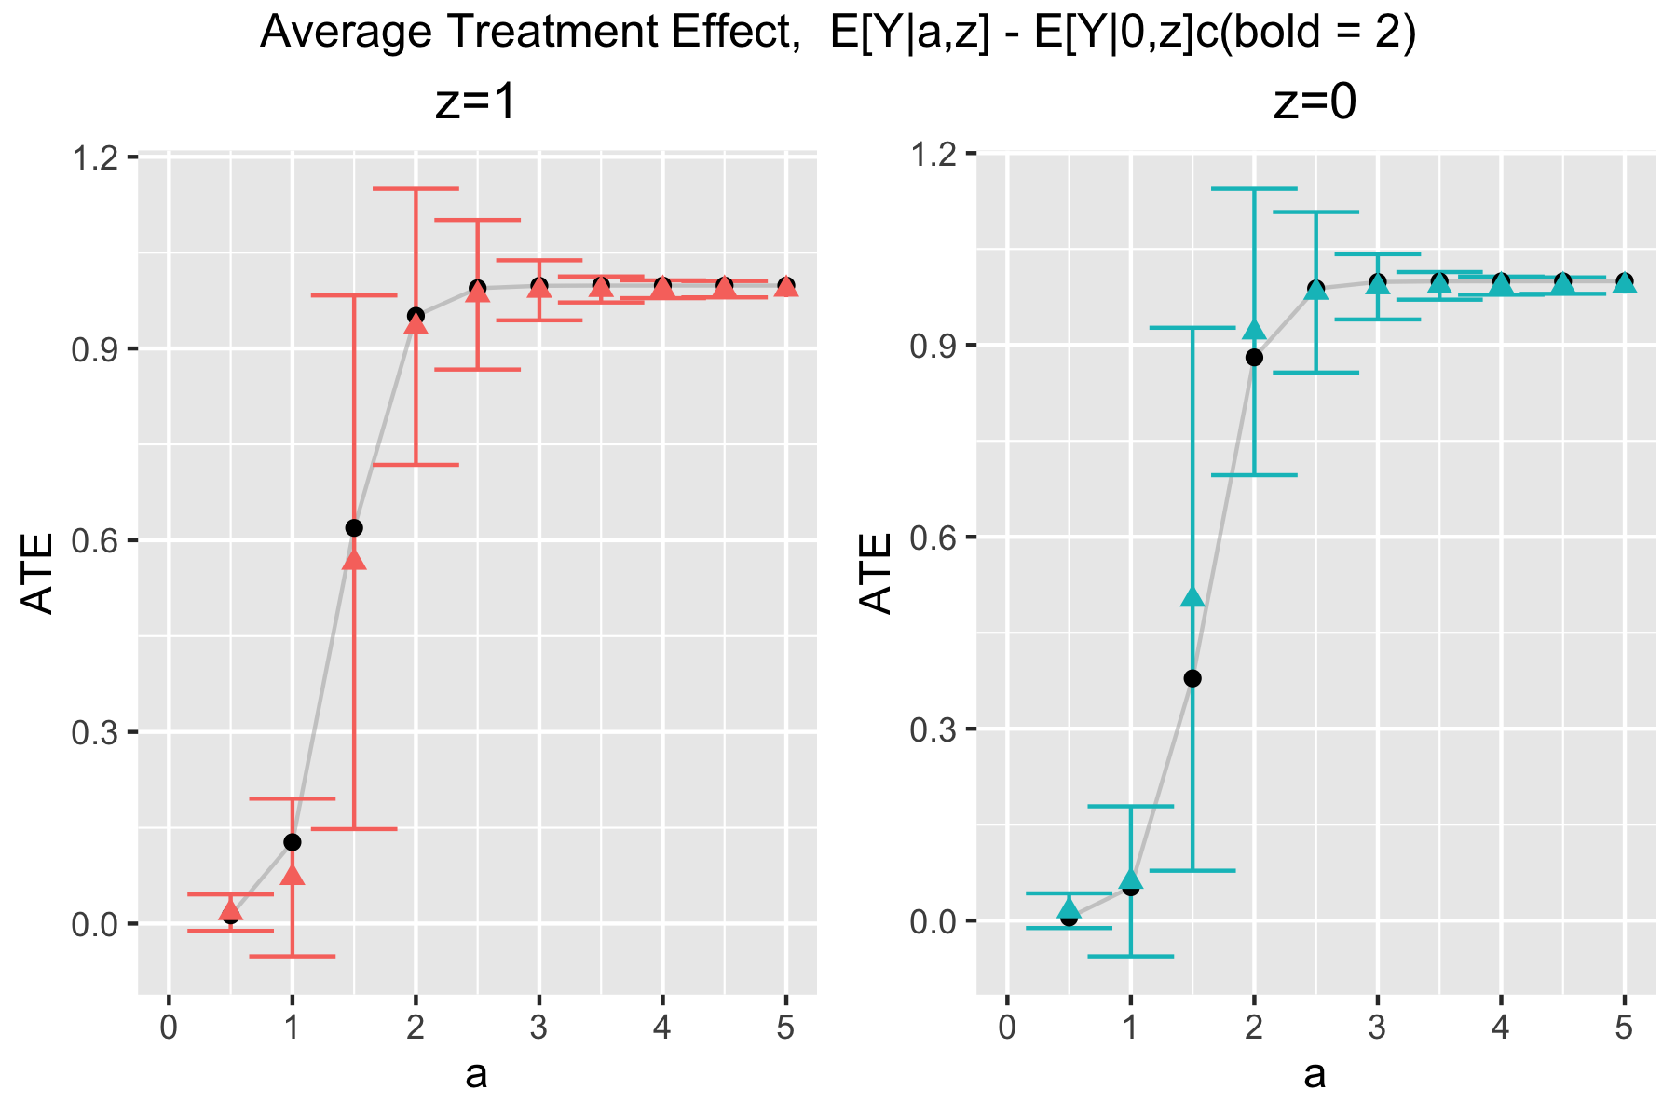
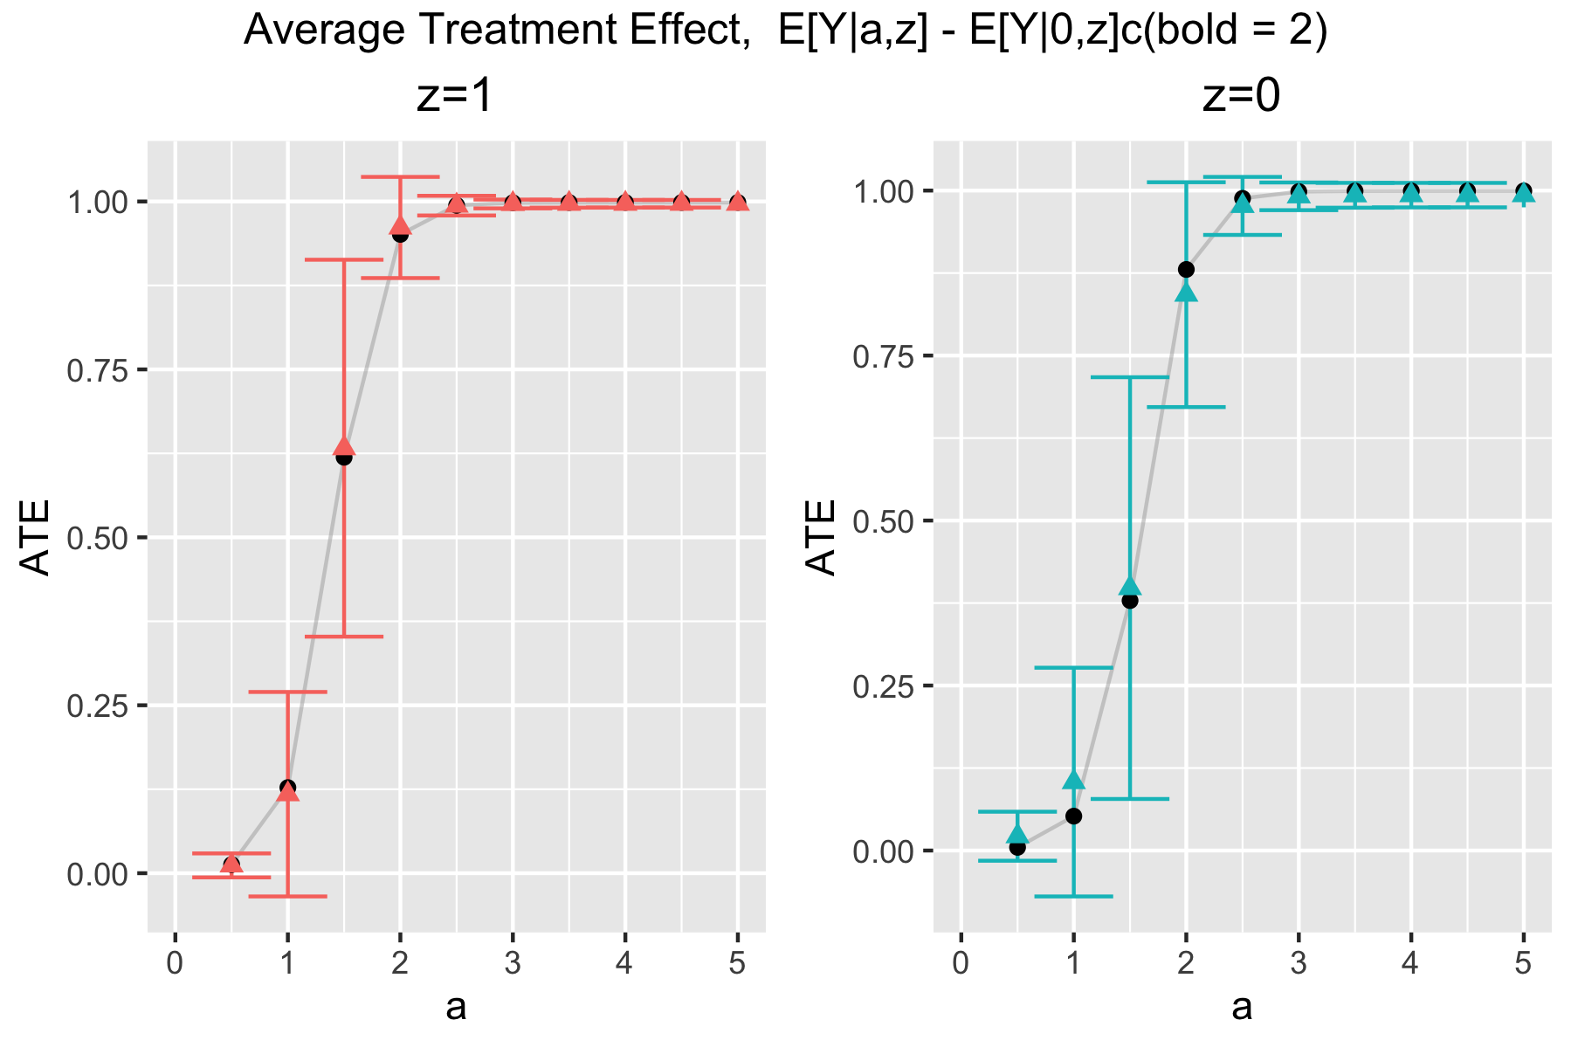
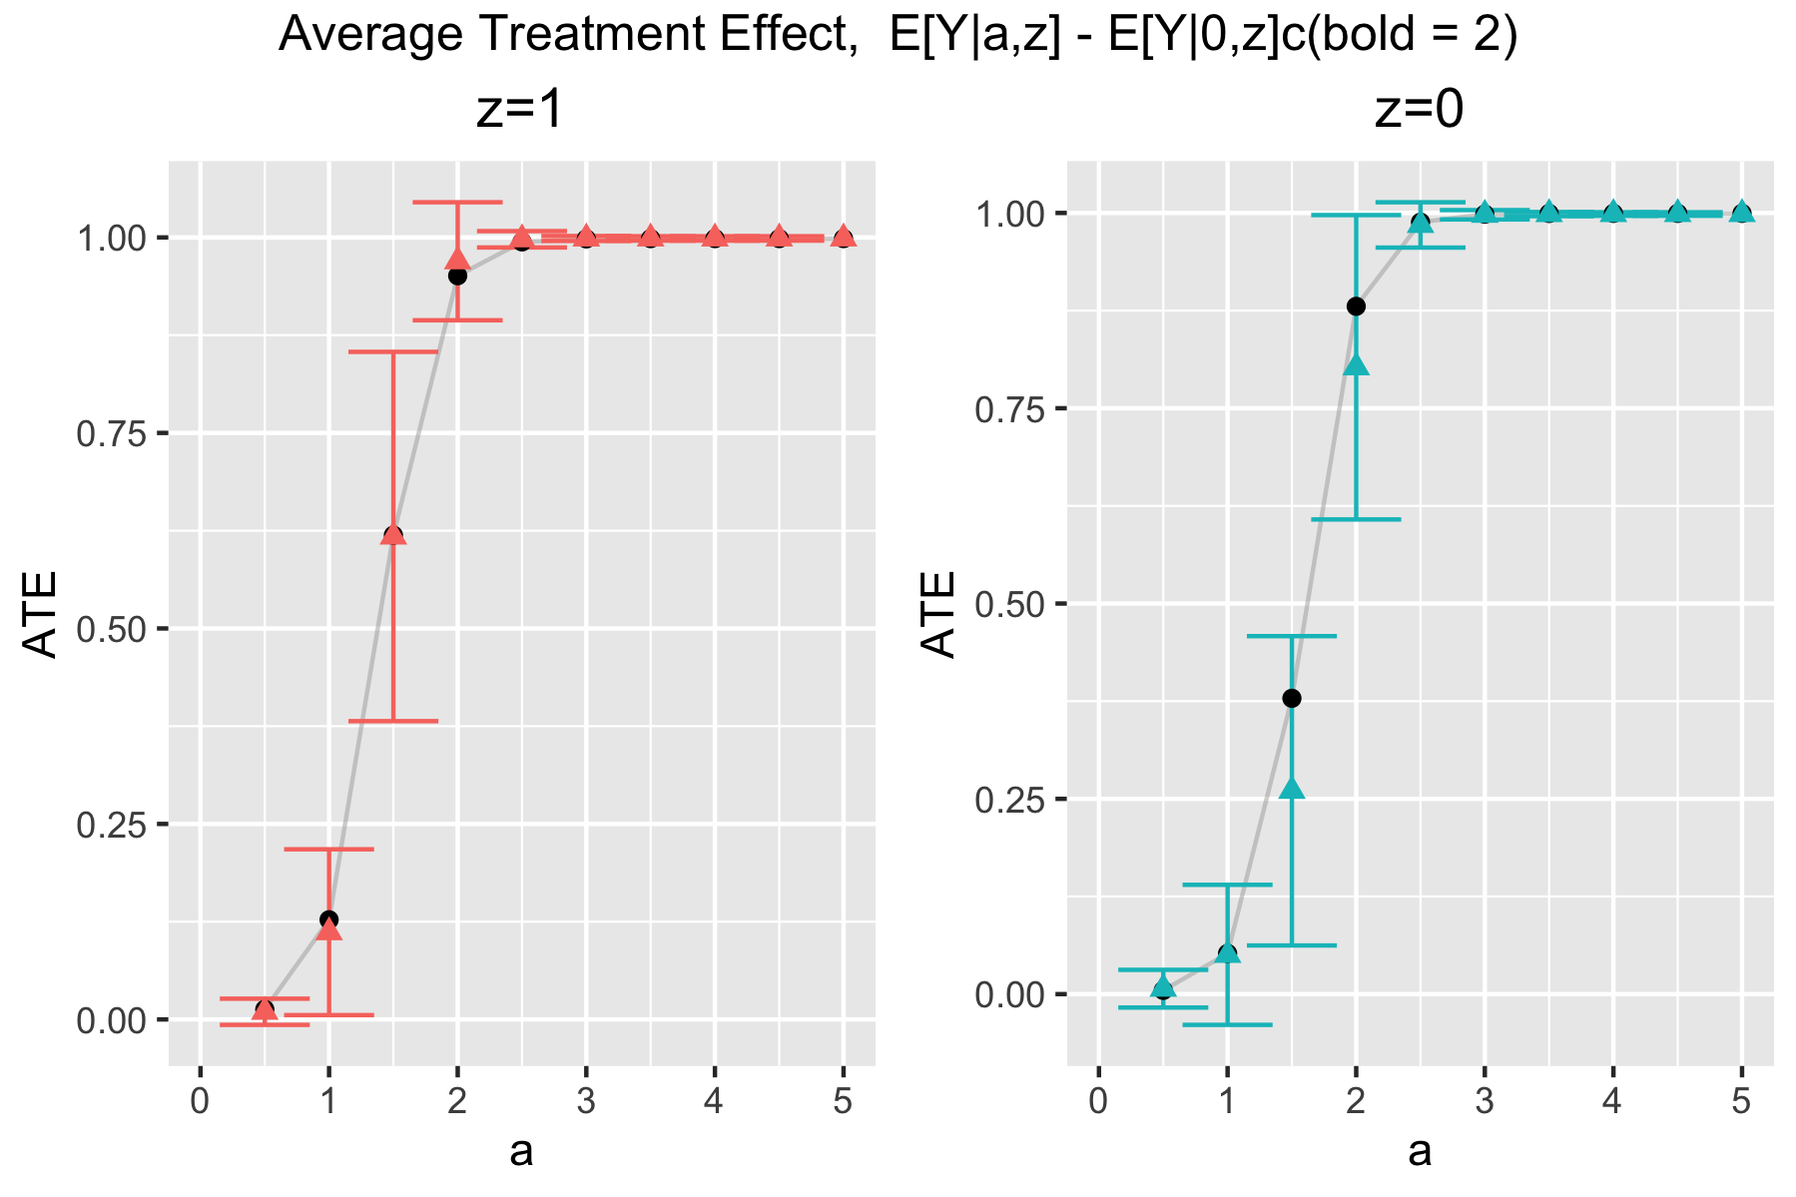
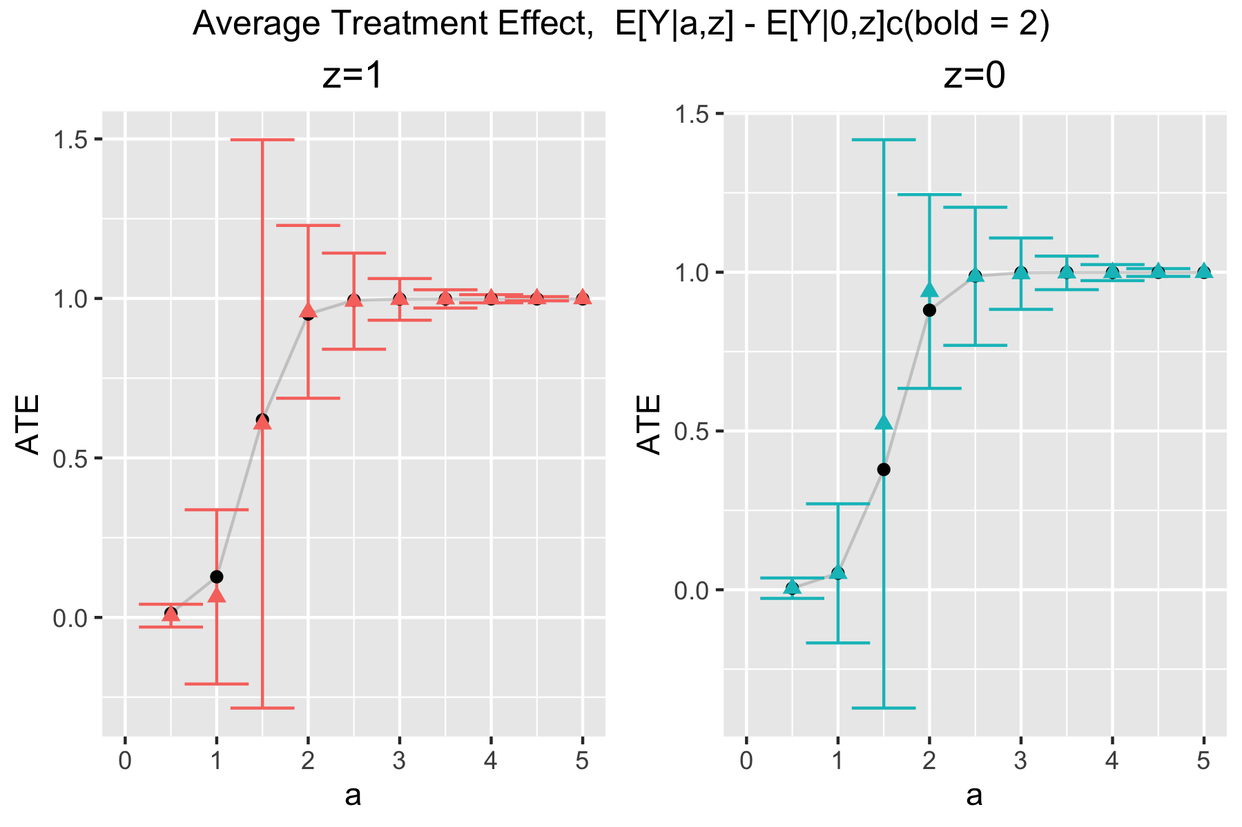
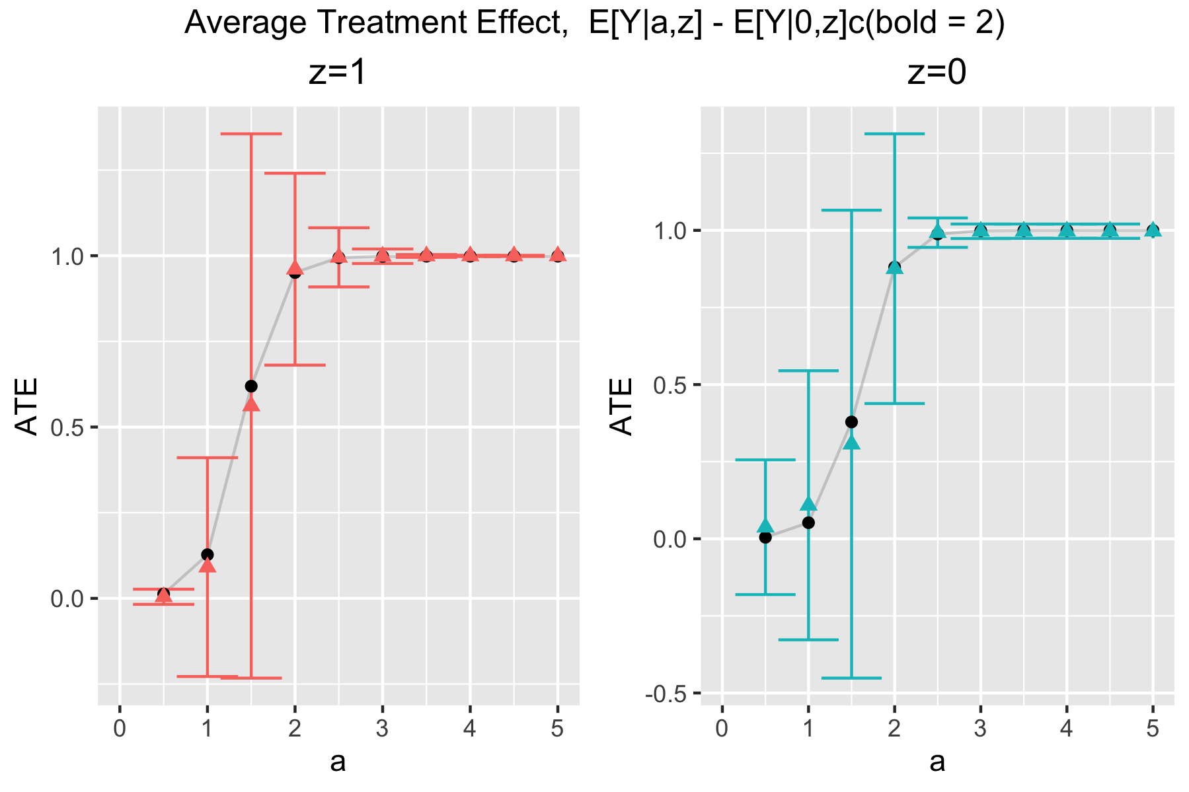
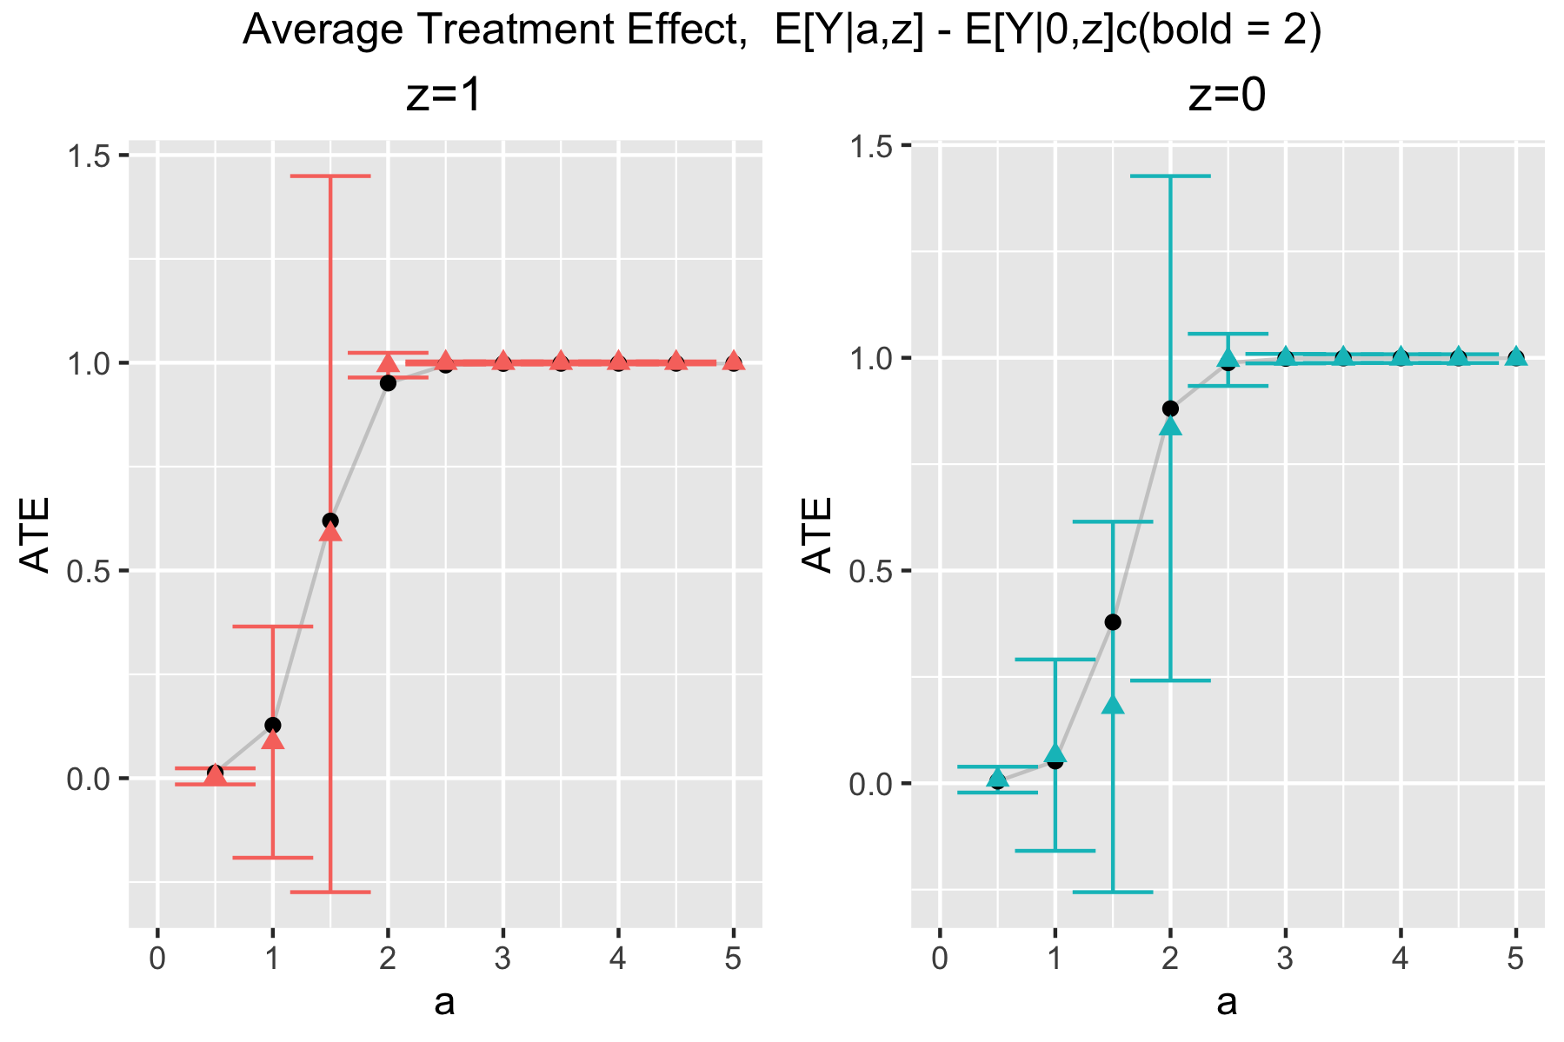
1 Sample
n = 200
n = 500
n = 1000
CV-HAL
Globally
undersmoothed
HAL

Slide 9
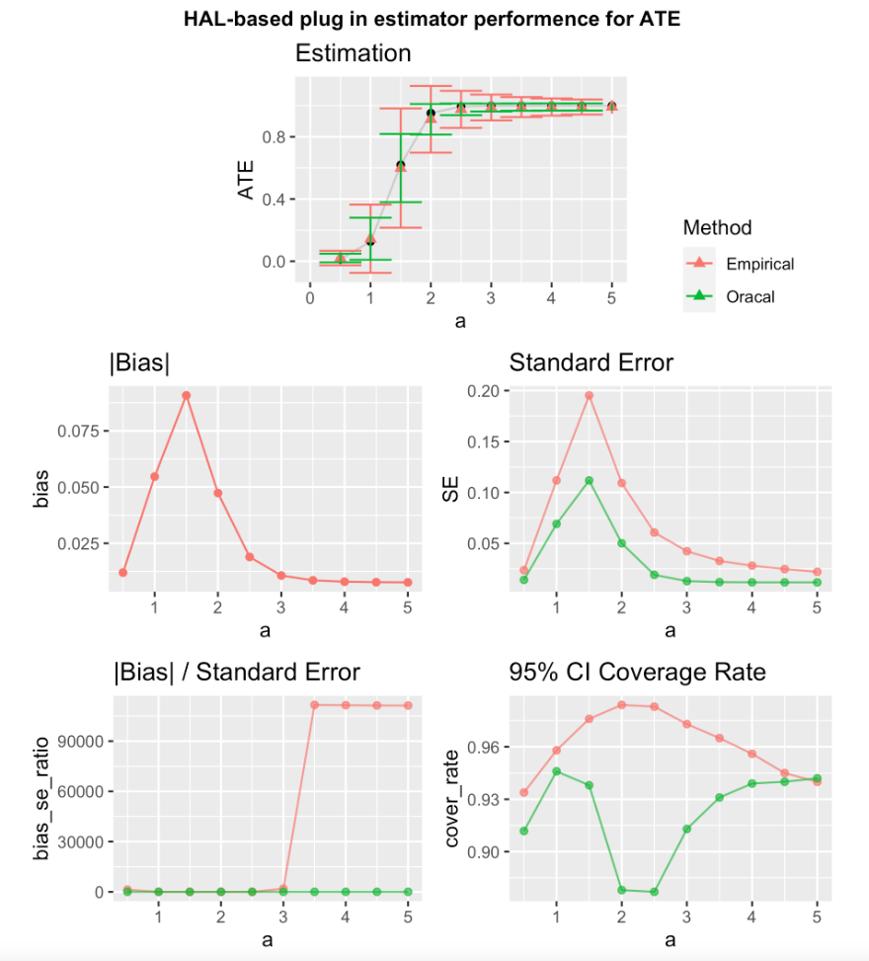
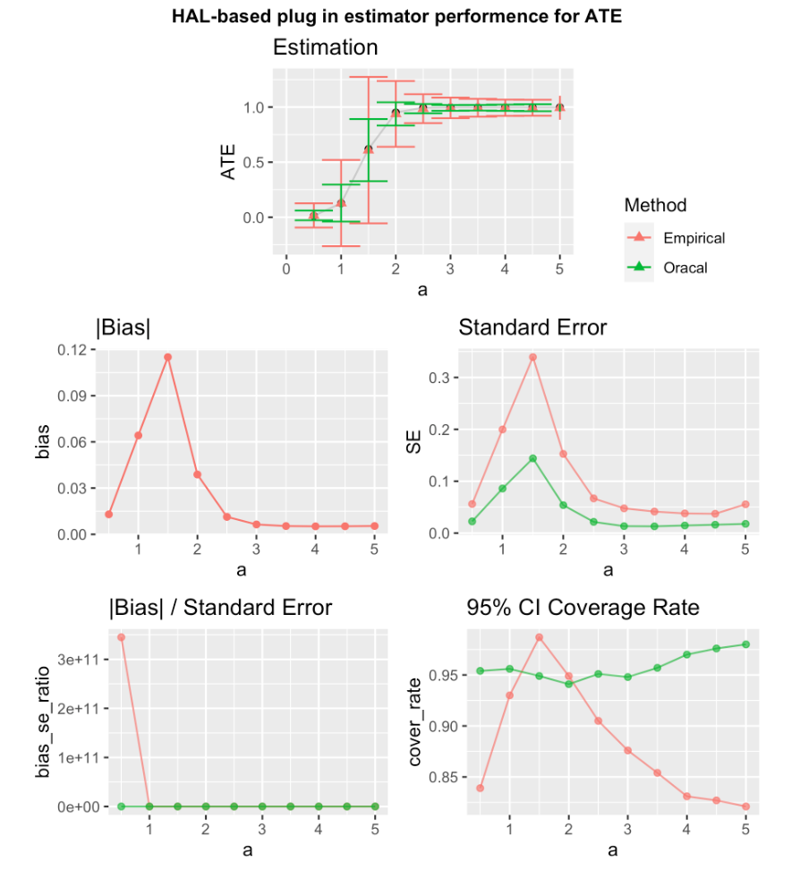
1000 Samples
n = 200, z = 1
CV-HAL
Globally undersmoothed HAL

Slide 10
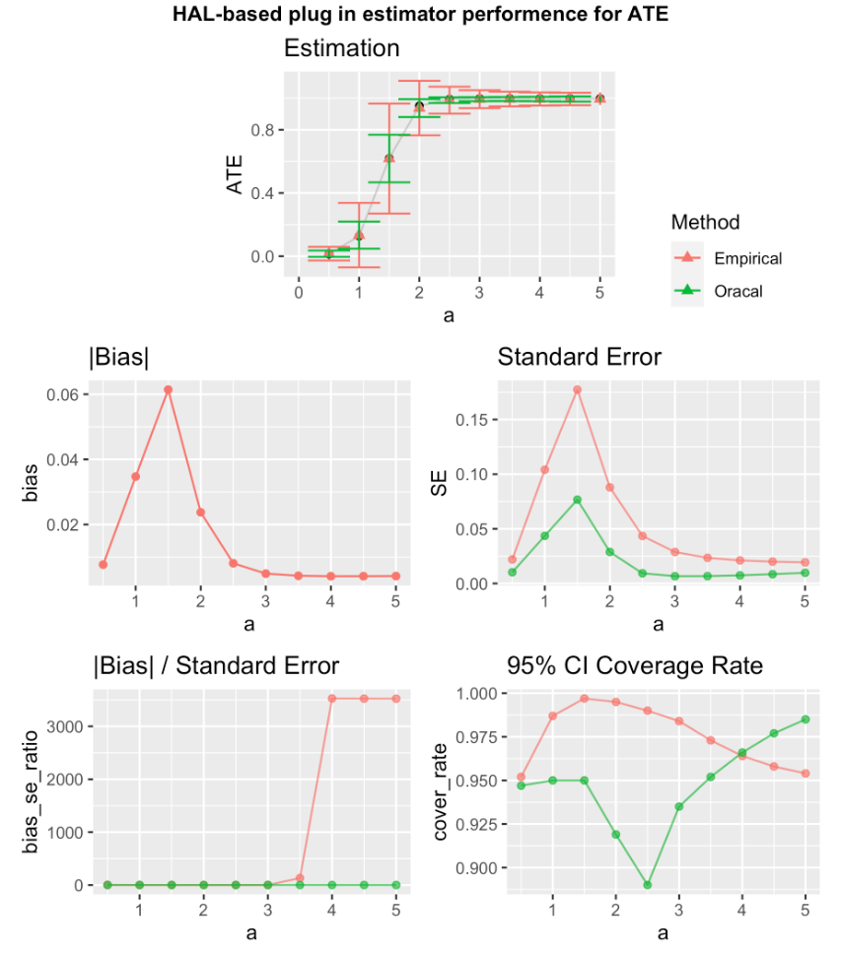
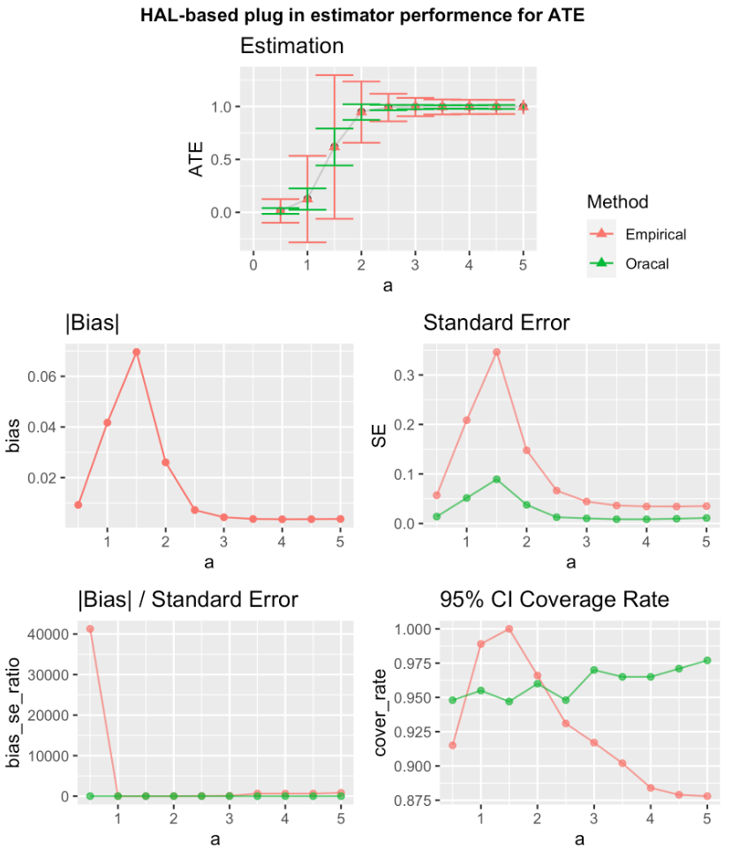
1000 Samples
n = 500, z = 1
CV-HAL
Globally undersmoothed HAL

Slide 11
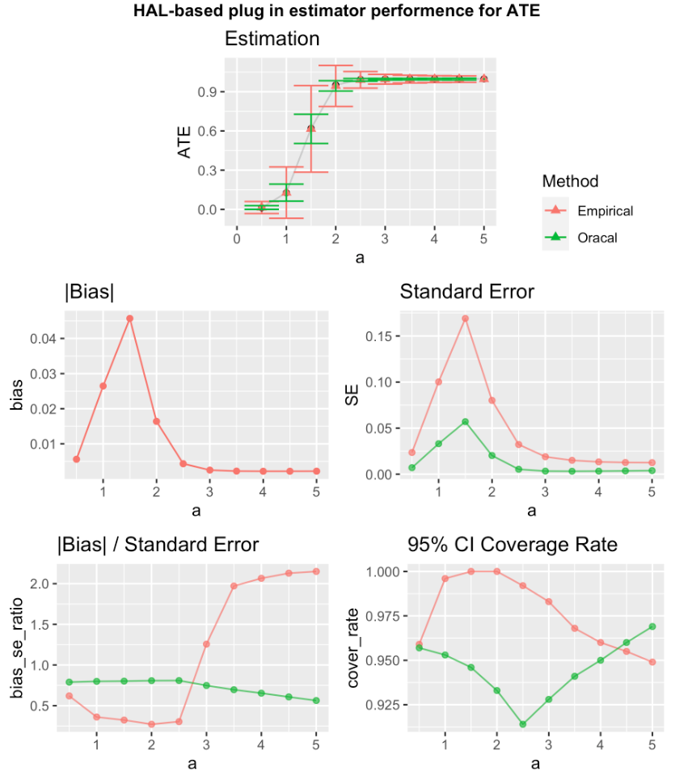
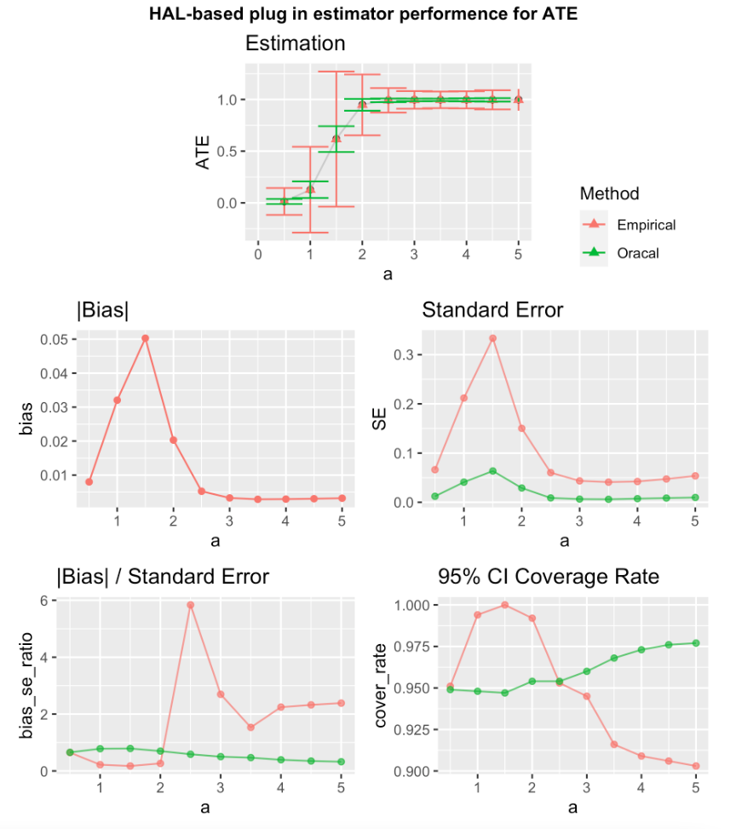
1000 Samples
n = 1000, z = 1
CV-HAL
Globally undersmoothed HAL

Slide 12
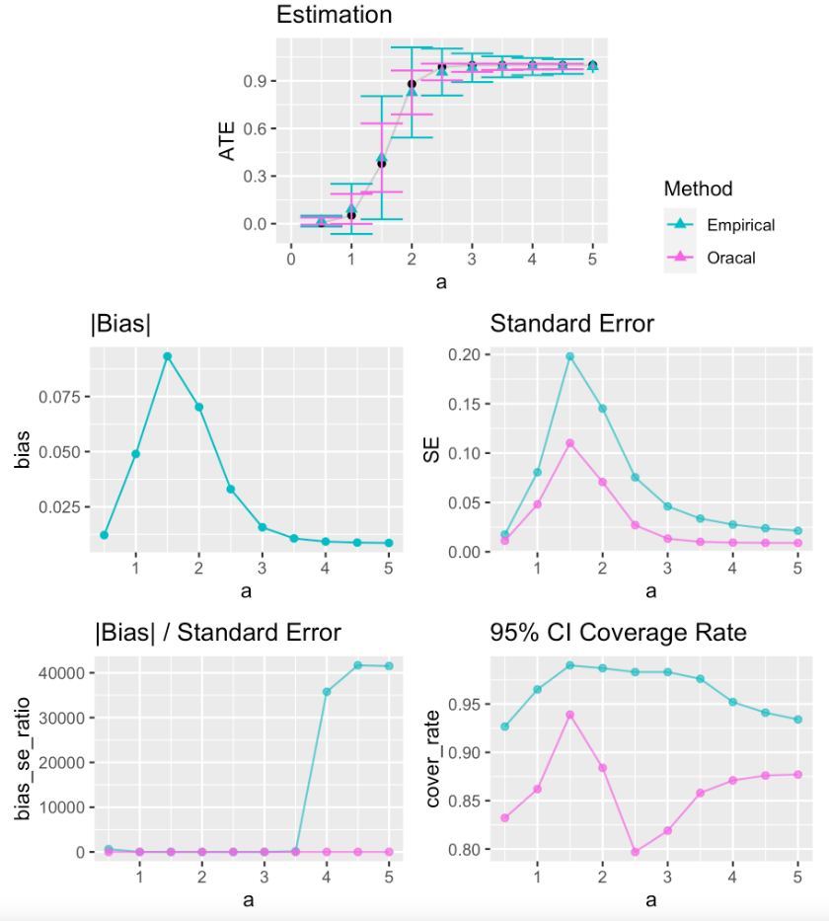
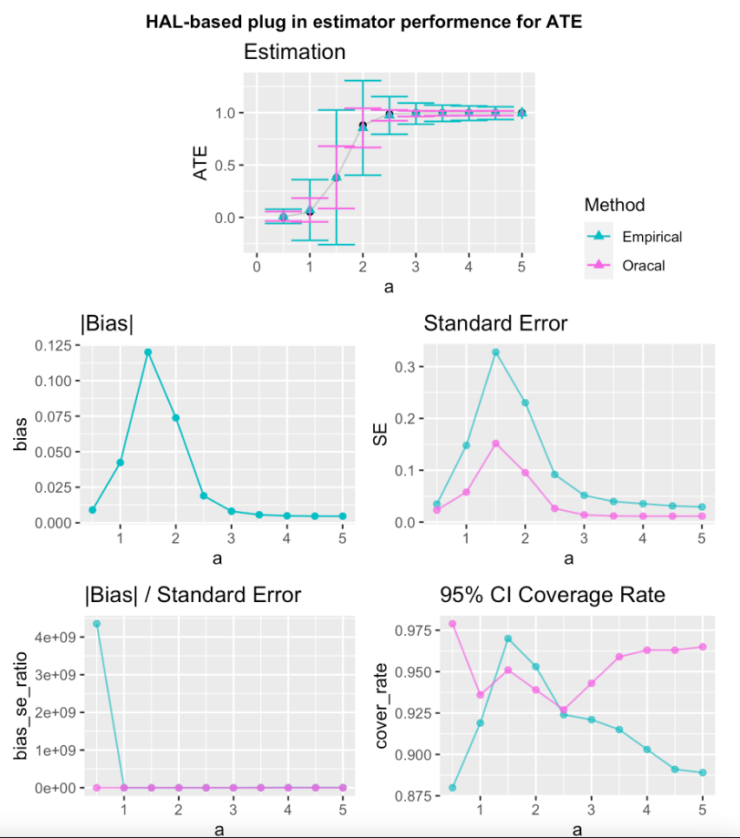
1000 Samples
n = 200, z = 0
CV-HAL
Globally undersmoothed HAL

Slide 13
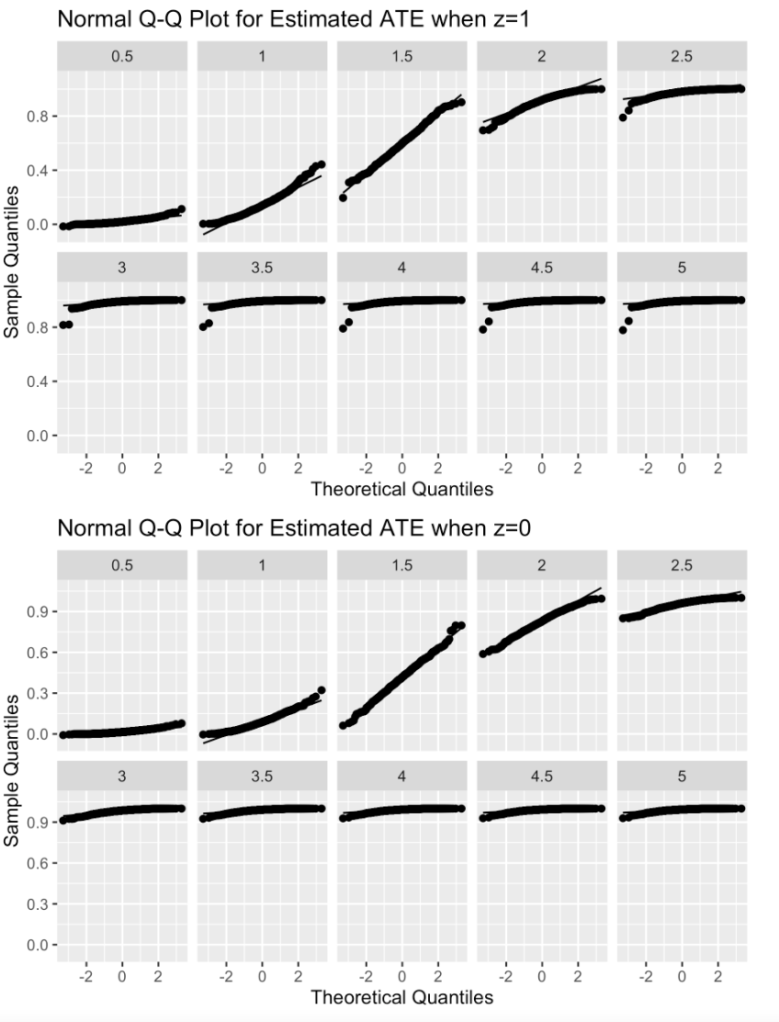
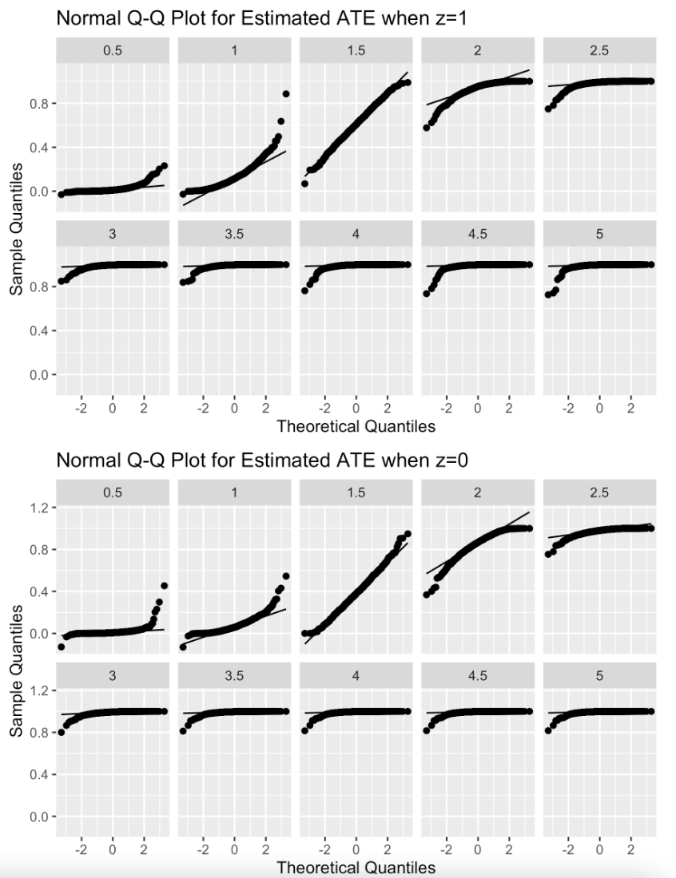
1000 Samples
n = 200
CV-HAL
Globally undersmoothed HAL

Slide 14
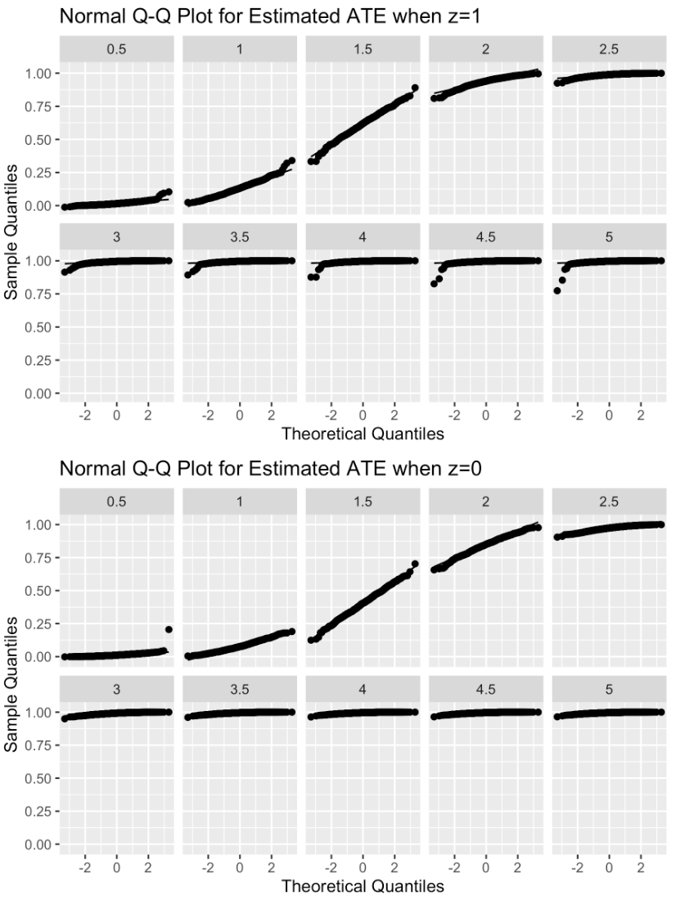
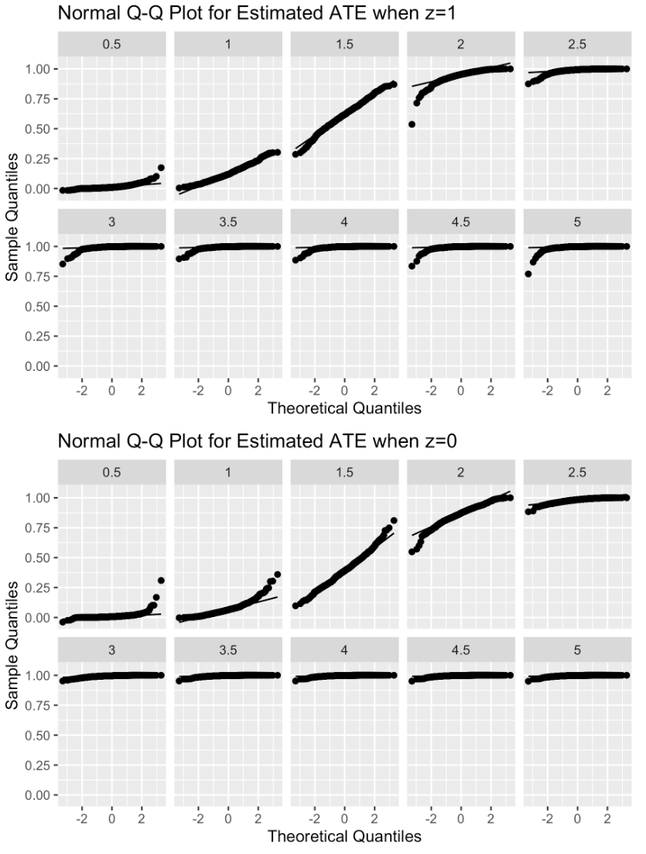
1000 Samples
n = 500
CV-HAL
Globally undersmoothed HAL

Slide 15
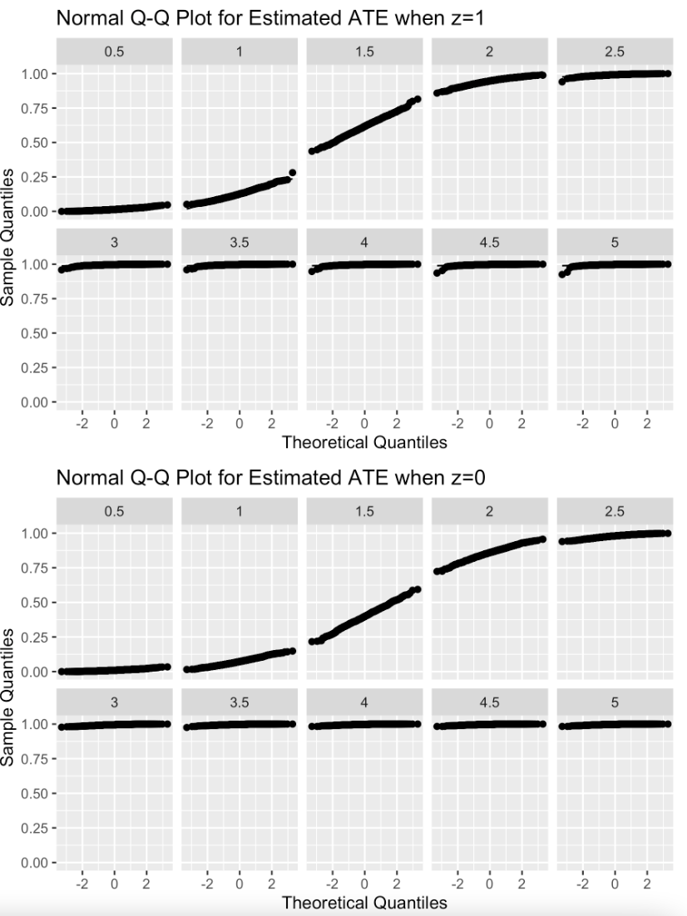
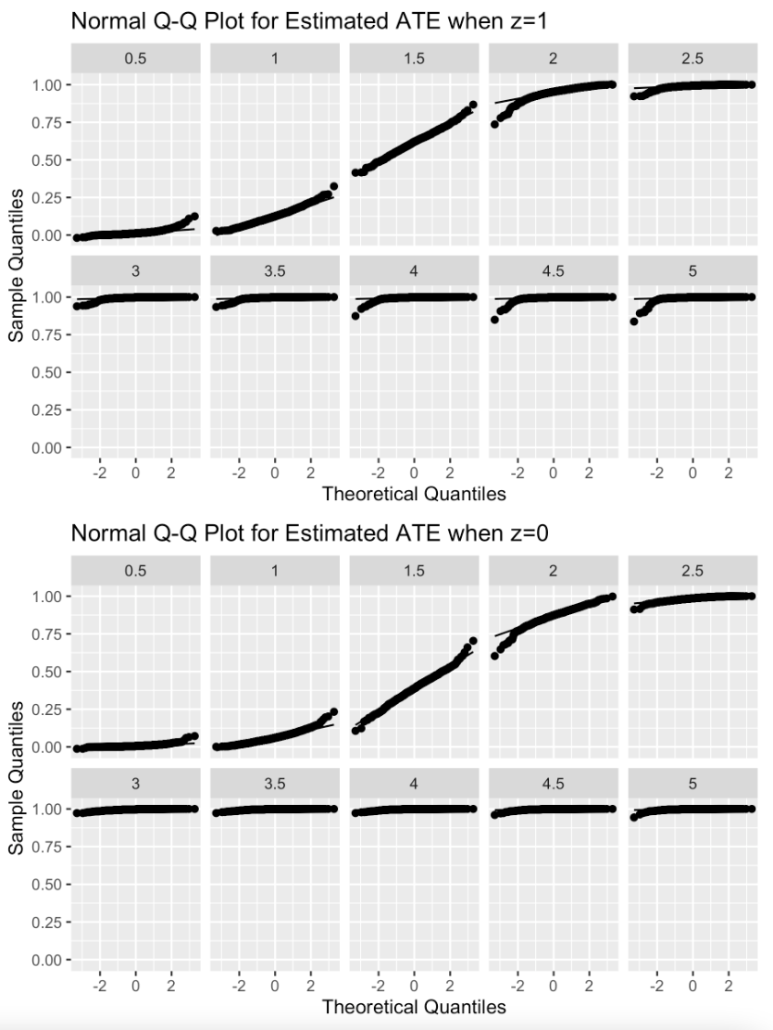
1000 Samples
n = 1000
CV-HAL
Globally undersmoothed HAL

Slide 16
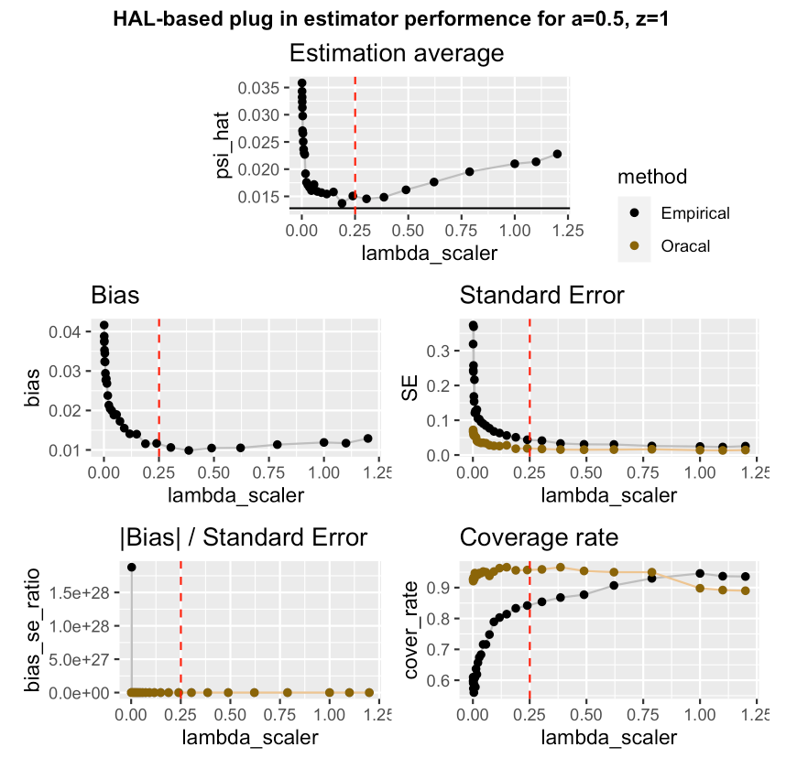
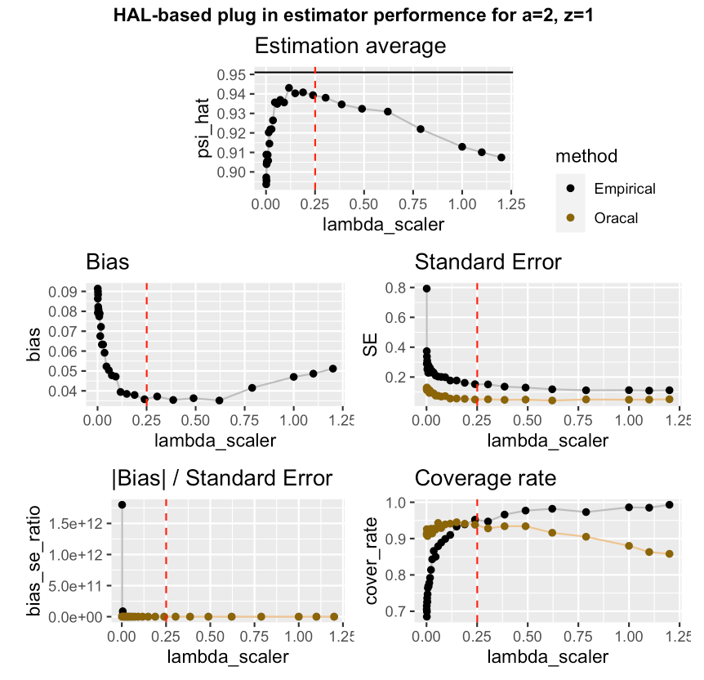
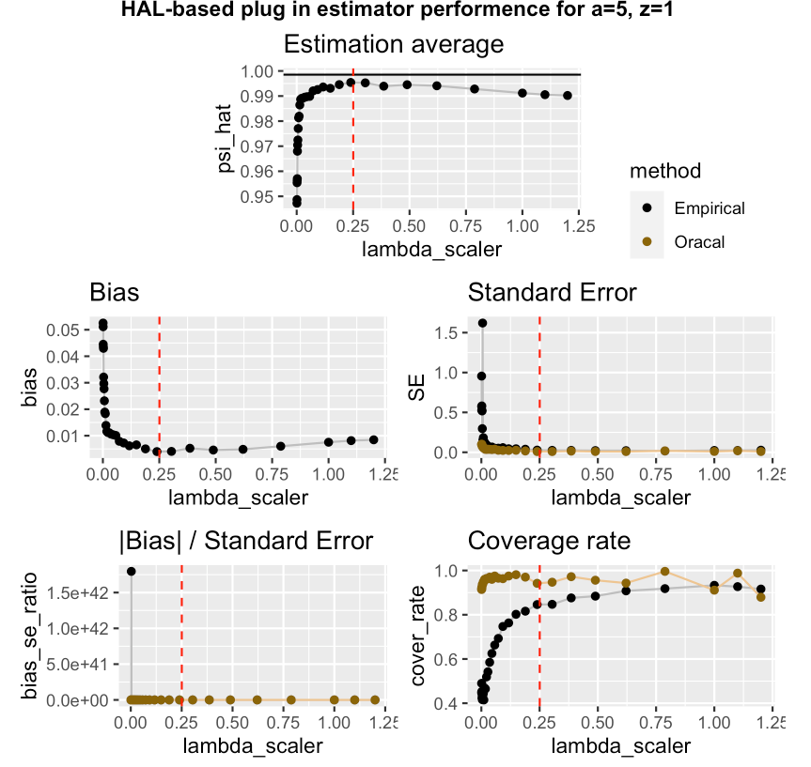
1000 Samples, n=200
Avg_scaler = 0.25055

Slide 17
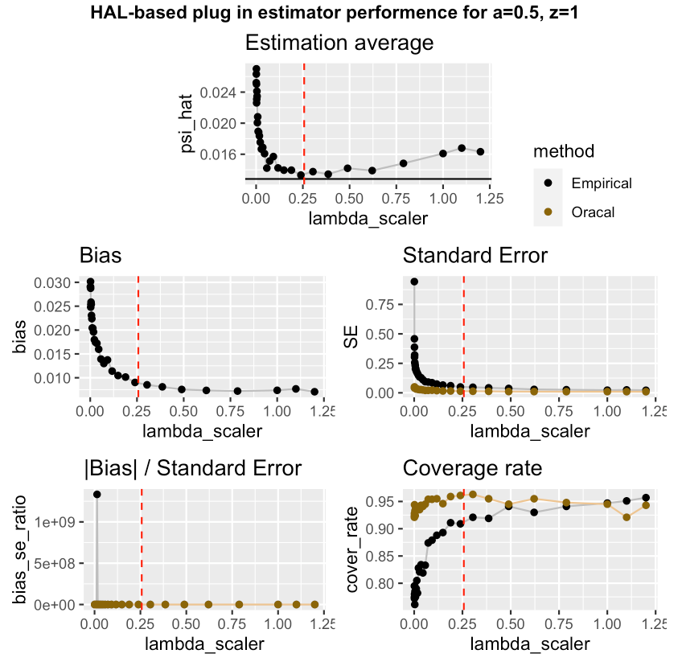
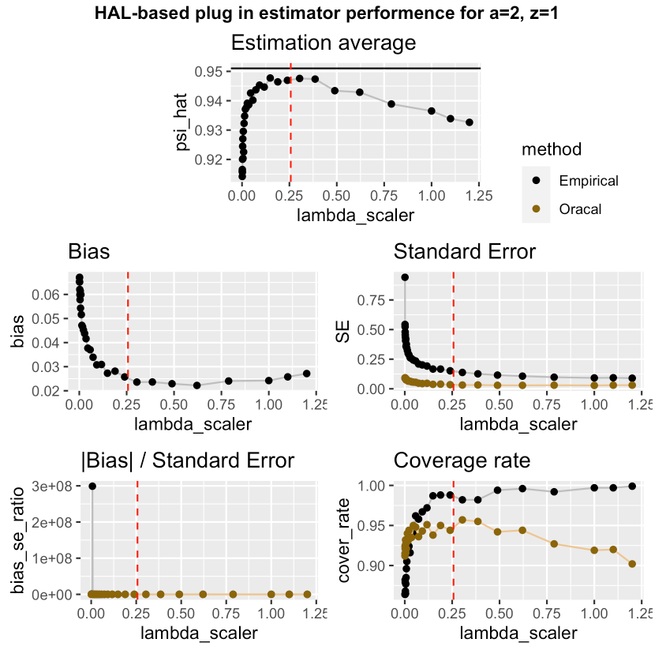
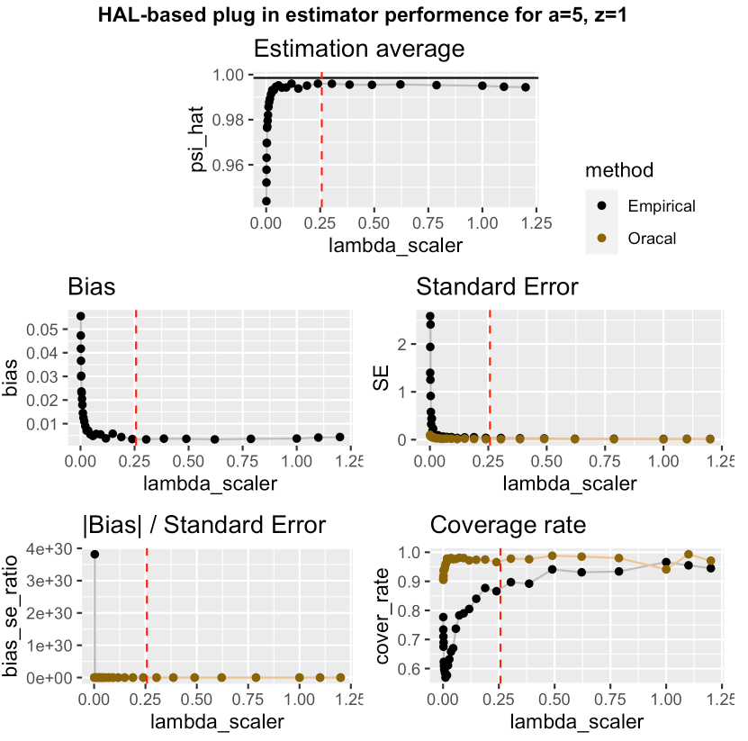
1000 Samples, n=500
Avg_scaler = 0.257085

Slide 18
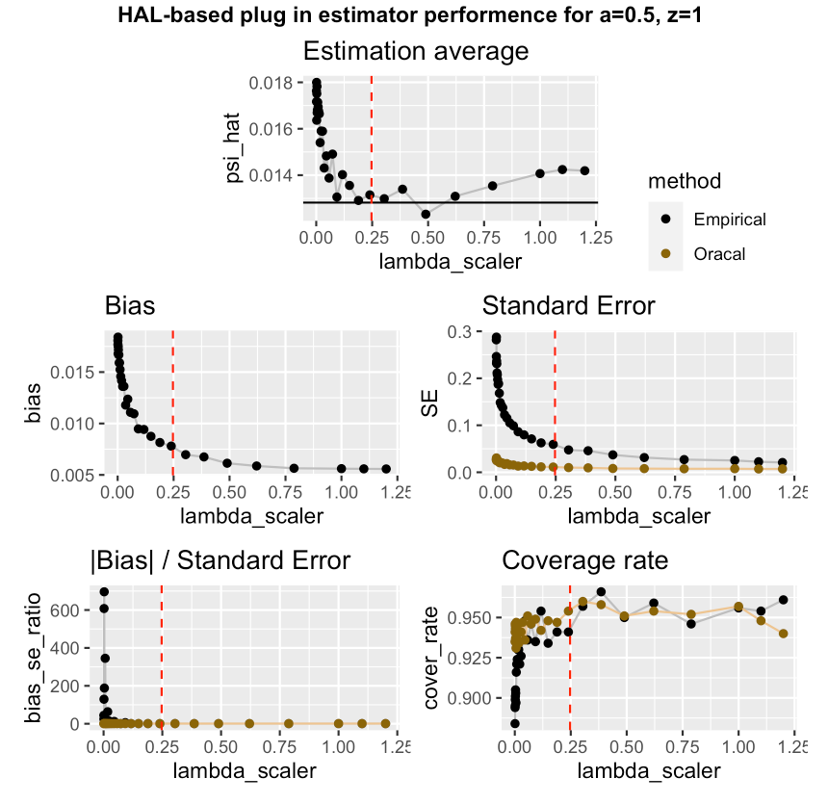
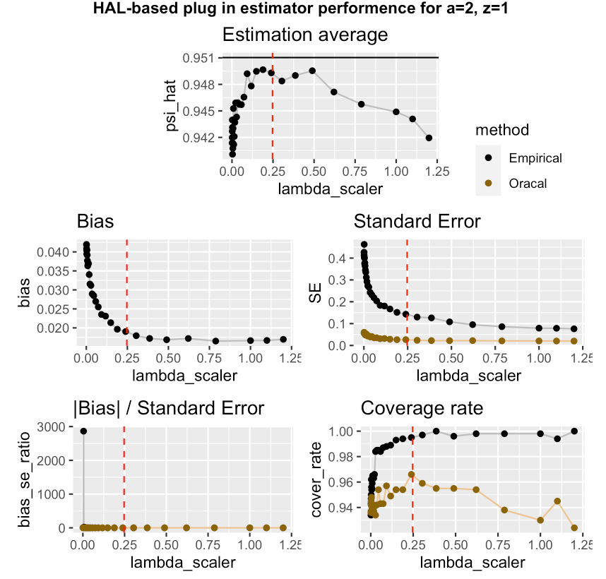
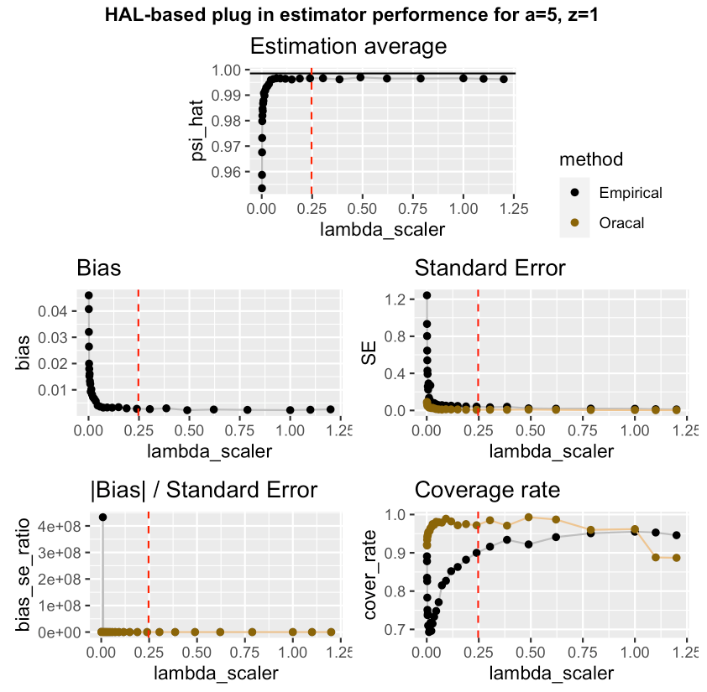
1000 Samples, n=1000
Avg_scaler = 0.24706

Slide 20
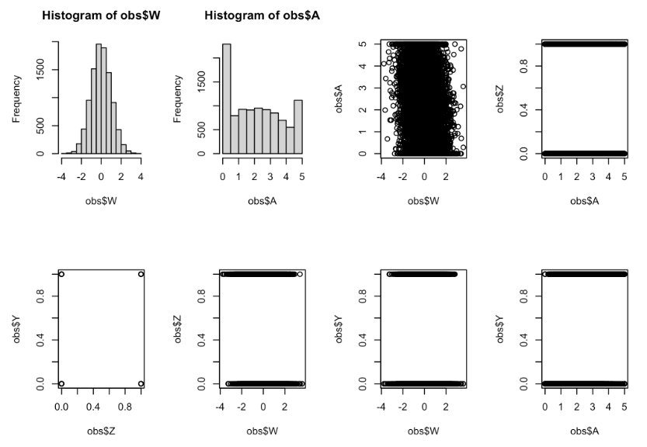
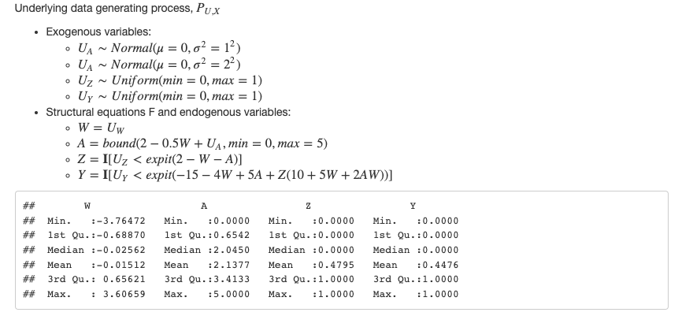
Simulation #2

Slide 21
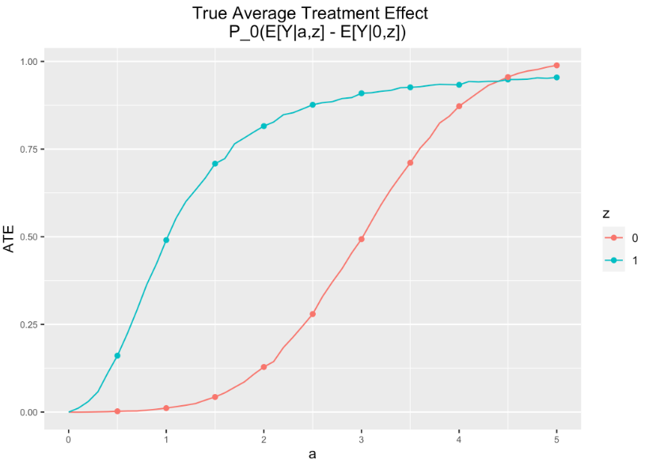
Simulation #2

Slide 22
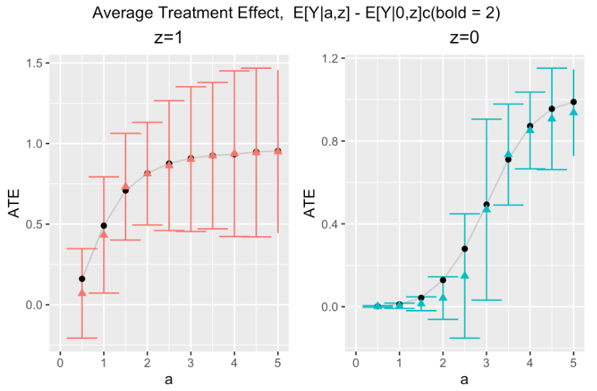
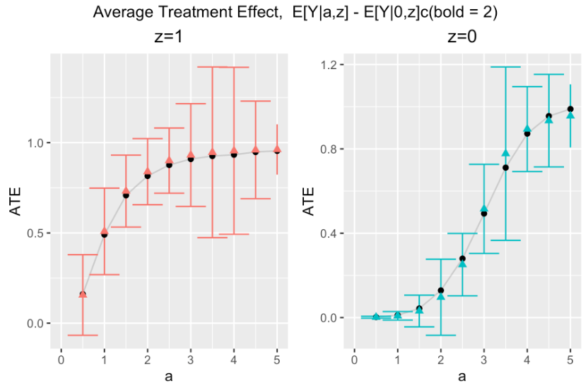
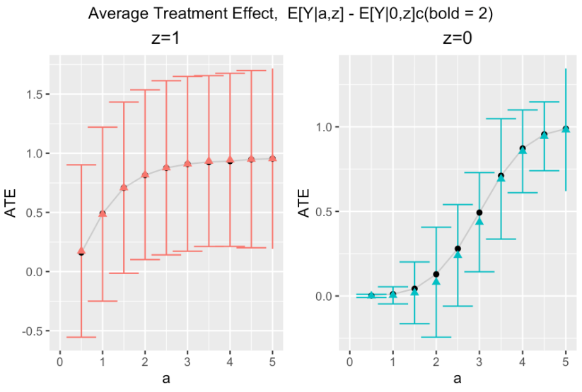
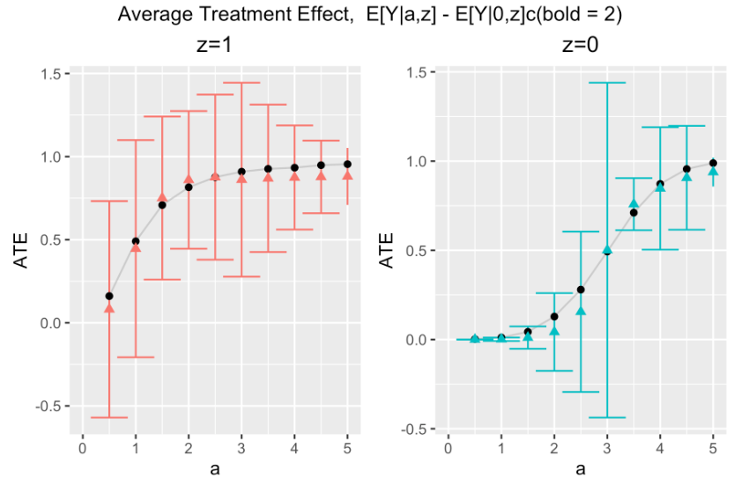
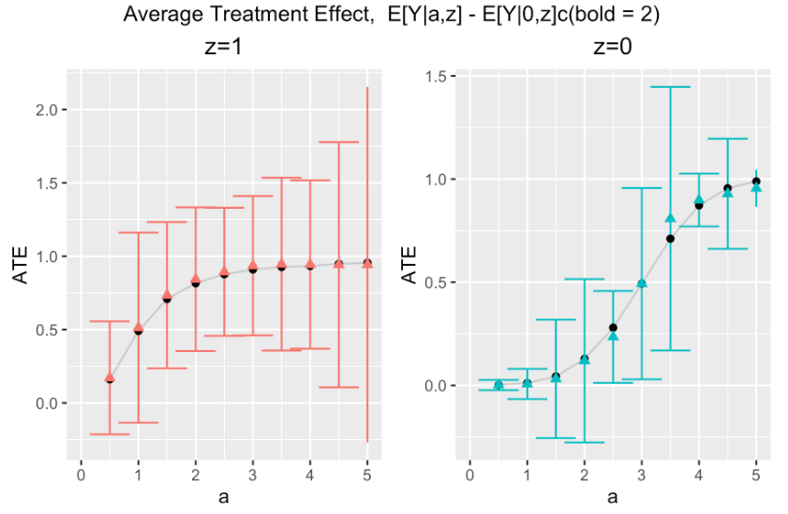
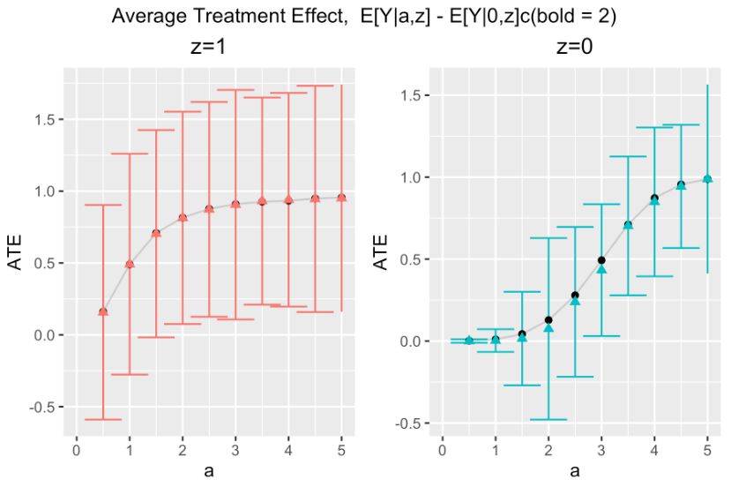
n = 200
n = 500
n = 1000
CV-HAL
Globally
undersmoothed
HAL
Undersmoothing lambda scaler
0.23357
0.16237
0.48329

Slide 23
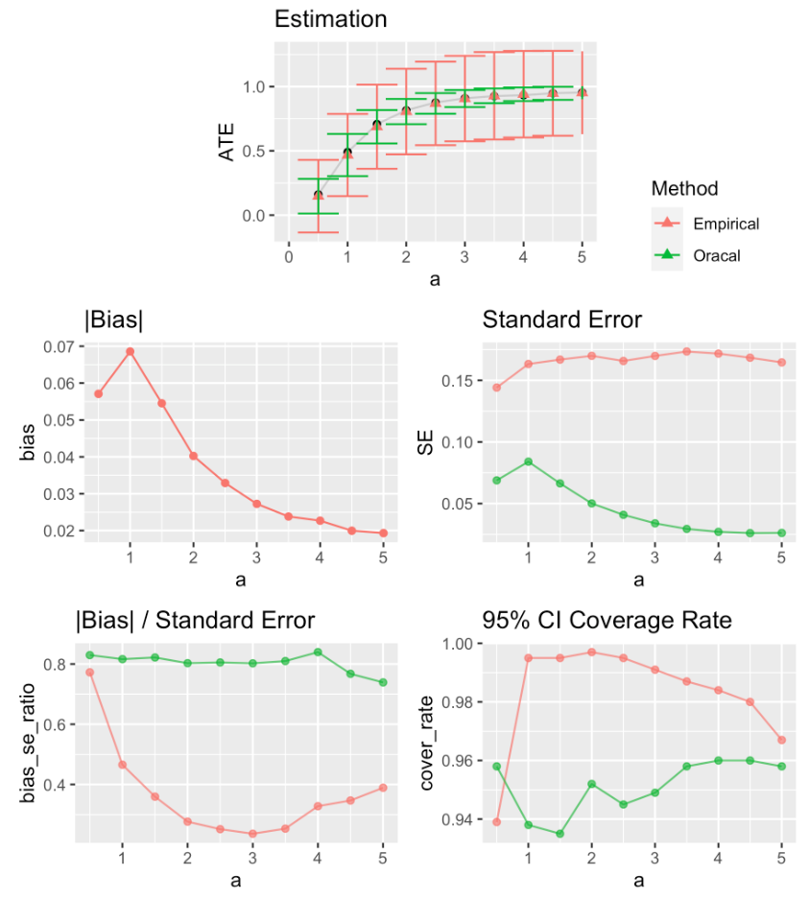
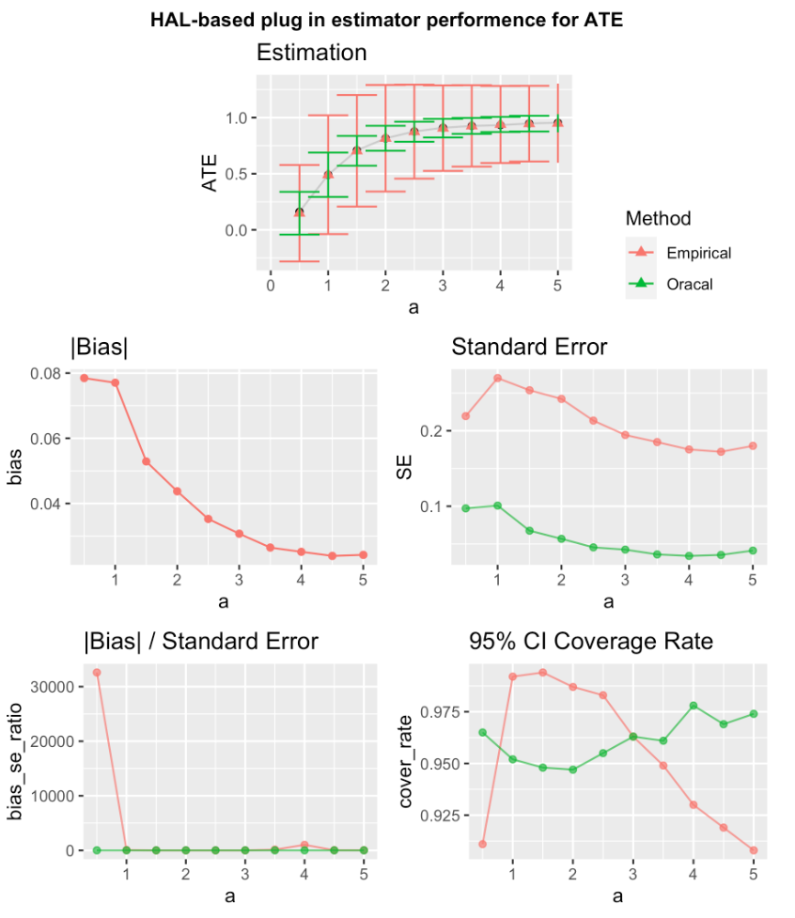
1000 Samples
n = 200, z = 1
CV-HAL
Globally undersmoothed HAL
0.21777

Slide 24
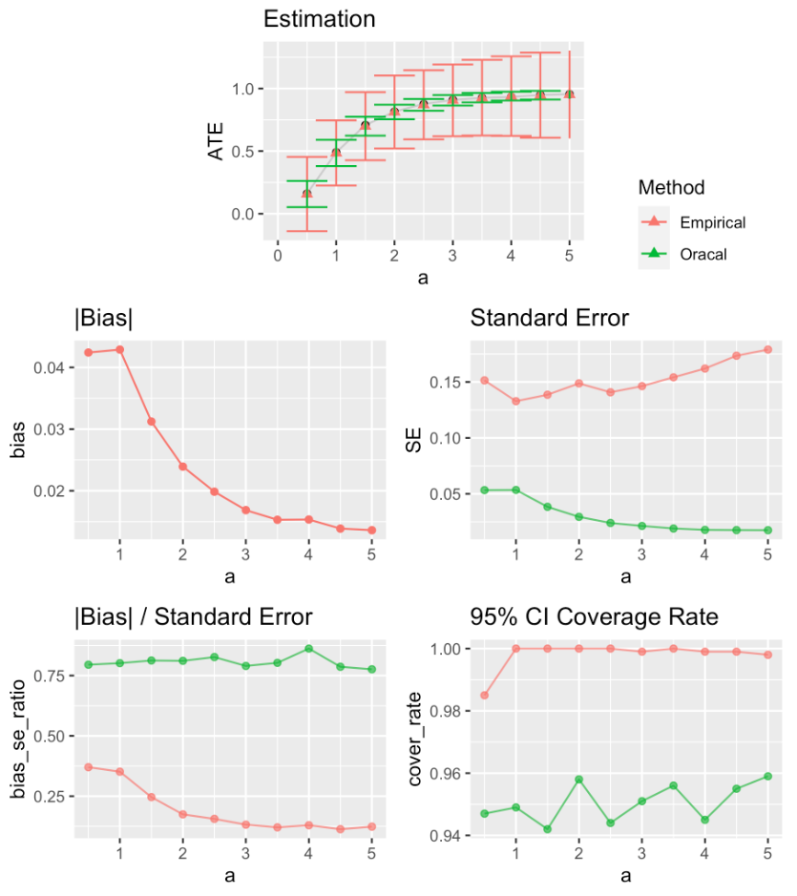
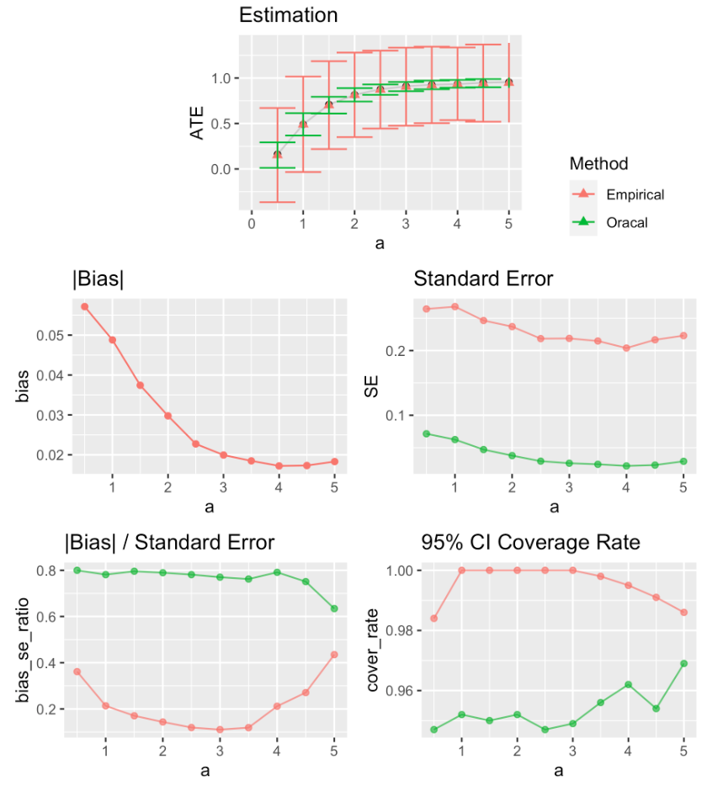
1000 Samples
0.2135
n = 500, z = 1
CV-HAL
Globally undersmoothed HAL

Slide 25
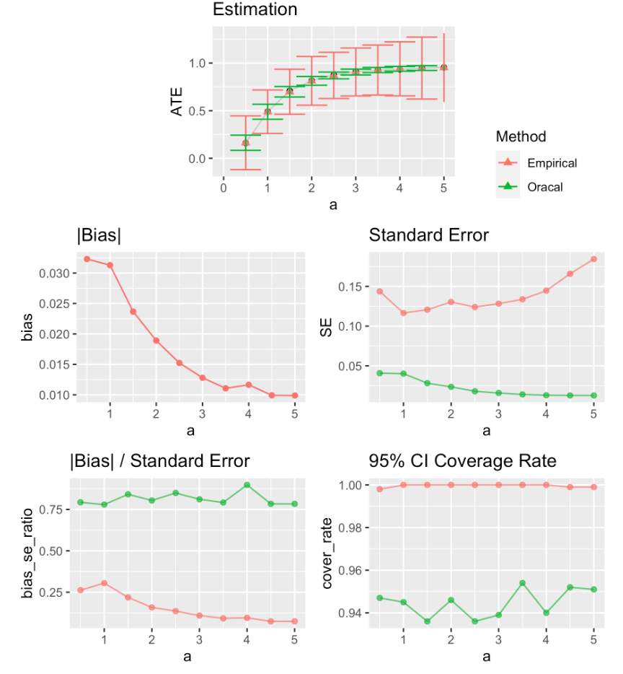
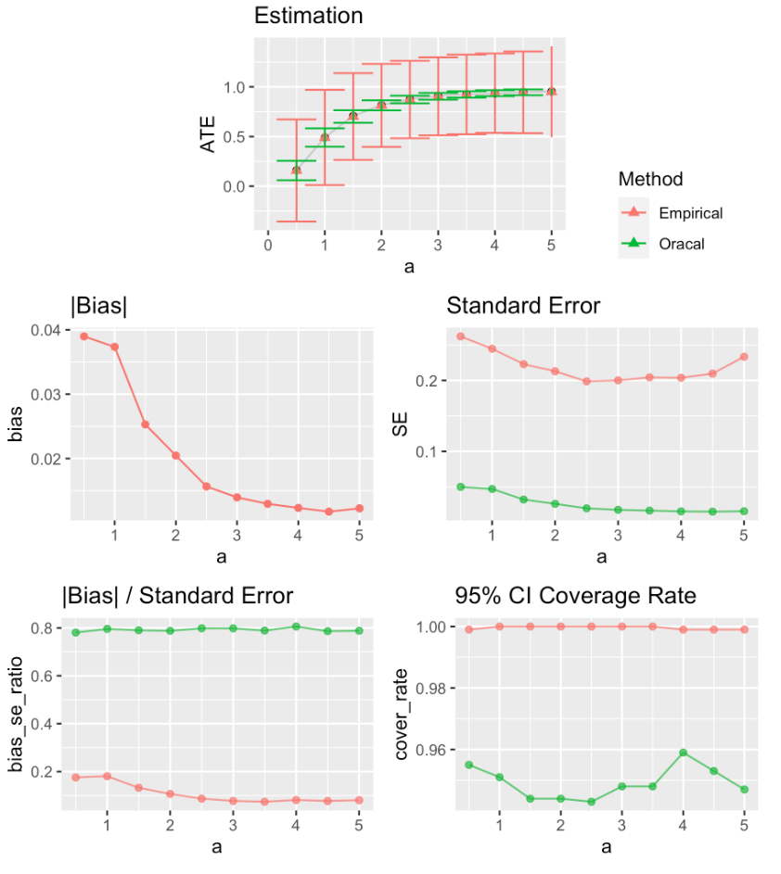
1000 Samples
0.2279
n = 1000, z = 1
CV-HAL
Globally undersmoothed HAL

Slide 26
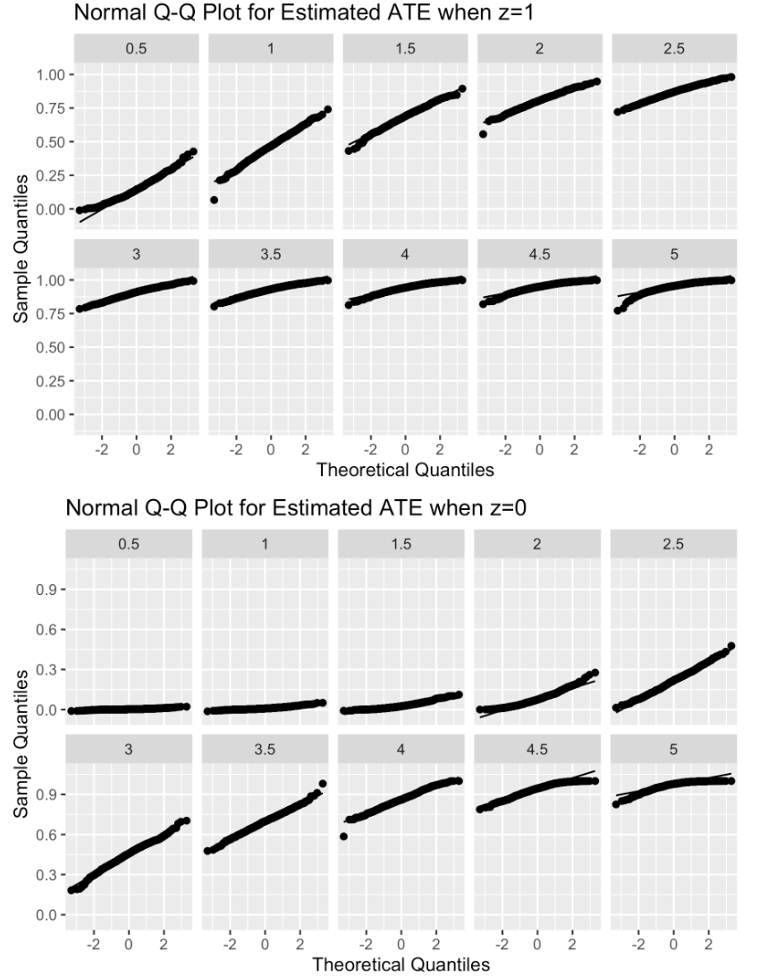
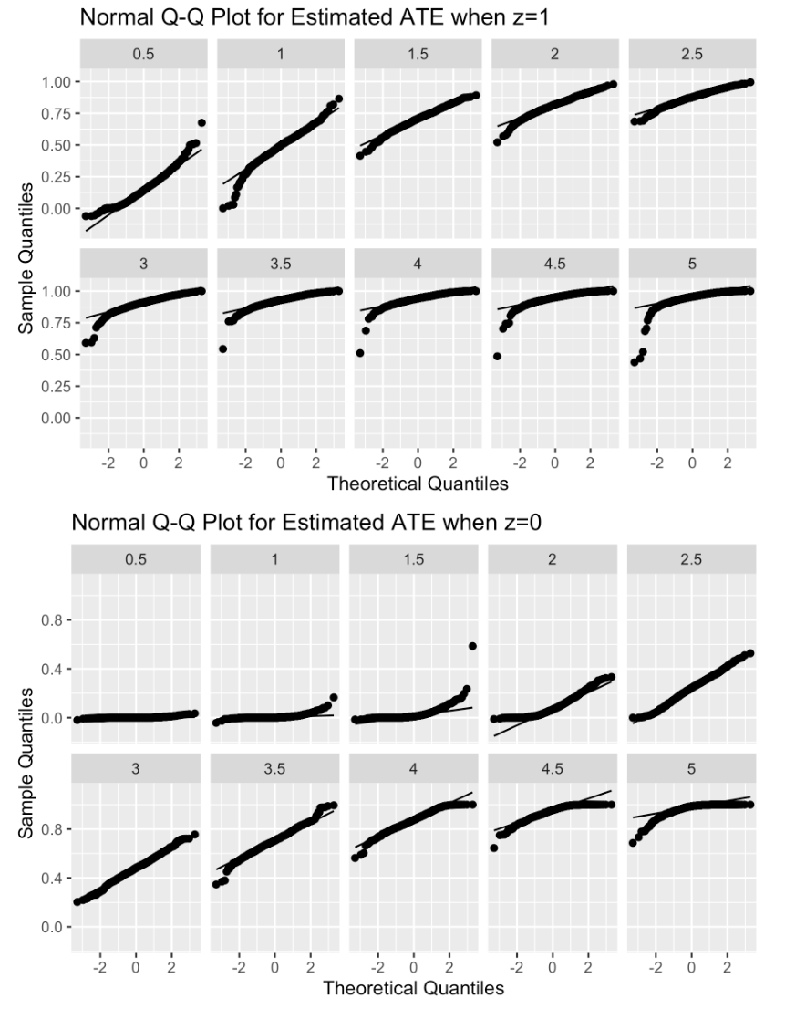
1000 Samples
n = 200
CV-HAL
Globally undersmoothed HAL

Slide 27
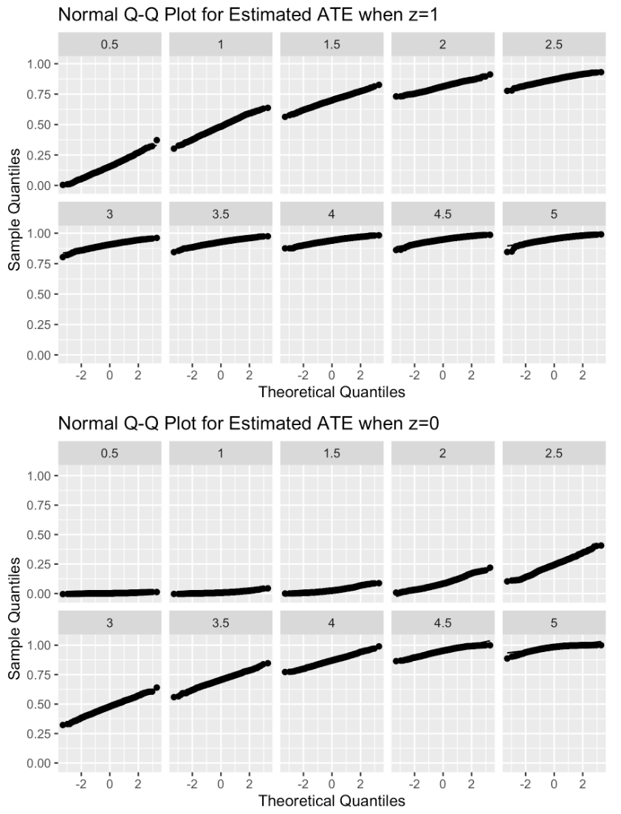

1000 Samples
n = 500
CV-HAL
Globally undersmoothed HAL

Slide 28


1000 Samples
n = 1000
CV-HAL
Globally undersmoothed HAL

Slide 29



1000 Samples, n=200
Avg_scaler = 0.21777

Slide 30



1000 Samples, n=500
Avg_scaler = 0.21359

Slide 32


Simulation #3

Slide 33

Simulation #3

Slide 34






n = 200
n = 500
n = 1000
CV-HAL
Globally
undersmoothed
HAL
Undersmoothing lambda scaler
0.23357
0.16237
0.16237

Slide 35


1000 Samples
n = 200, z = 1
CV-HAL
Globally undersmoothed HAL
Sample size no big enough for undersmoothing

Slide 36


1000 Samples
Avg_scaler = 0.16237
n = 500, z = 1
CV-HAL
Globally undersmoothed HAL

Slide 37

1000 Samples
Avg_scaler = 0.16237
n = 1000, z = 1
CV-HAL
Globally undersmoothed HAL

Slide 38

1000 Samples
n = 200, z = 0
CV-HAL
Globally undersmoothed HAL
Sample size no big enough for undersmoothing

Slide 39


1000 Samples
n = 500, z = 0
CV-HAL
Globally undersmoothed HAL

Slide 40

1000 Samples
n = 1000, z = 0
CV-HAL
Globally undersmoothed HAL

Slide 41

1000 Samples
n = 200
CV-HAL
Globally undersmoothed HAL
Sample size no big enough for undersmoothing

Slide 42


1000 Samples
Avg_scaler = 0.16237
n = 500
CV-HAL
Globally undersmoothed HAL

Slide 43

1000 Samples
Avg_scaler = 0.16237
n = 1000
CV-HAL
Globally undersmoothed HAL

Slide 44
1000 Samples
Avg_scaler = 0.16237
n = 1000
CV-HAL
Globally undersmoothed HAL

